Slide 1
SAWE
Canadian Chapter
Survey on Communication & Events
May 2019
Results

Slide 2
Background & Summary
Following discussions at monthly Chapter executive meetings on a range of topics it was agreed to survey the chapter to ascertain their views.
Survey was issued to individuals who were members of the chapter during 2018 (30 members in total.)
Results are presented in following slides.
Discussion and action plan to be progressed over coming months.

Slide 3
Canadian Chapter Communications

Slide 4
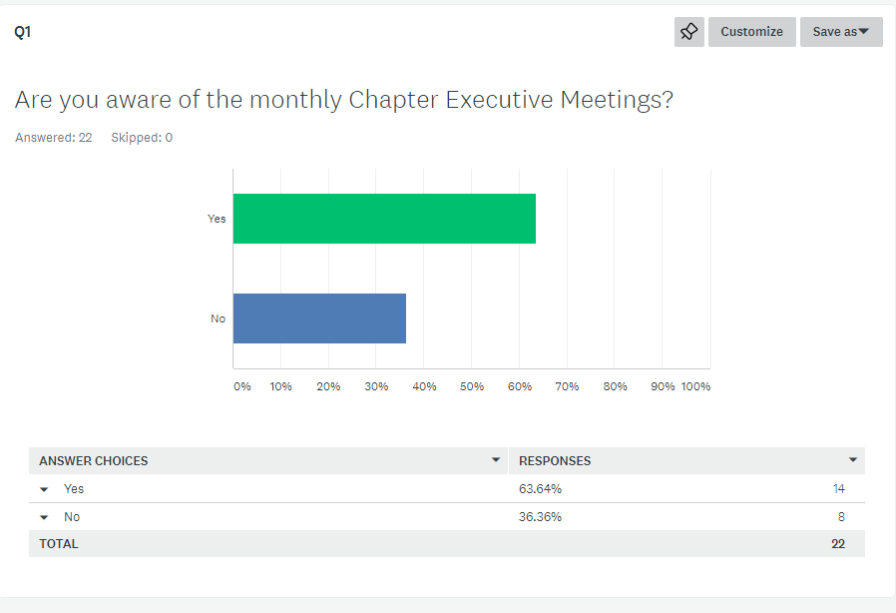

Slide 5
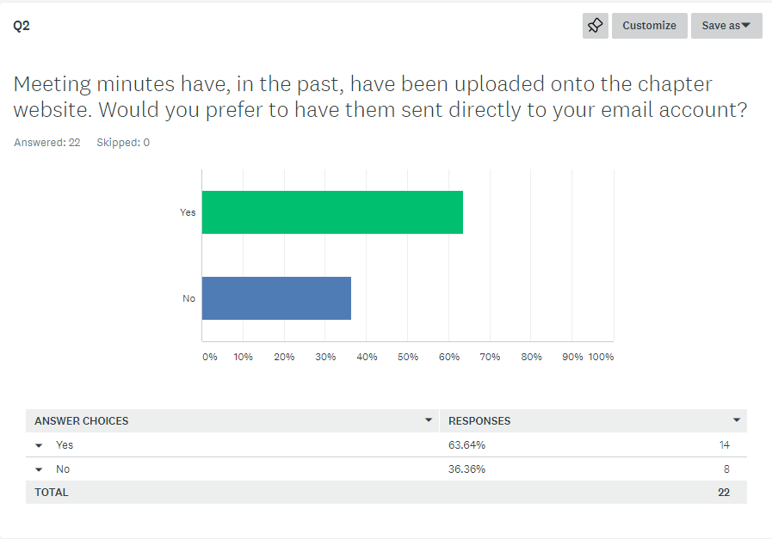

Slide 6
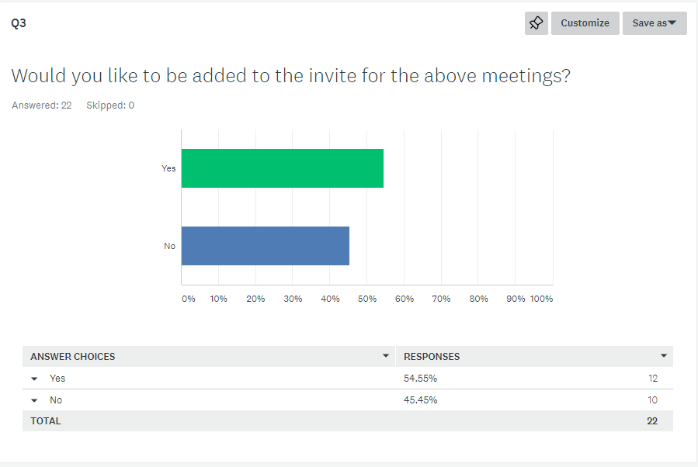

Slide 7
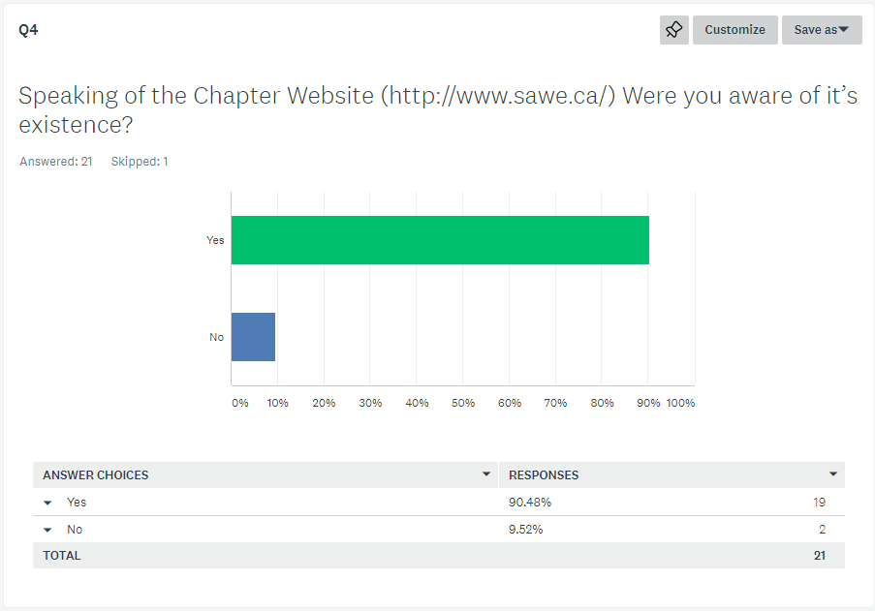

Slide 8
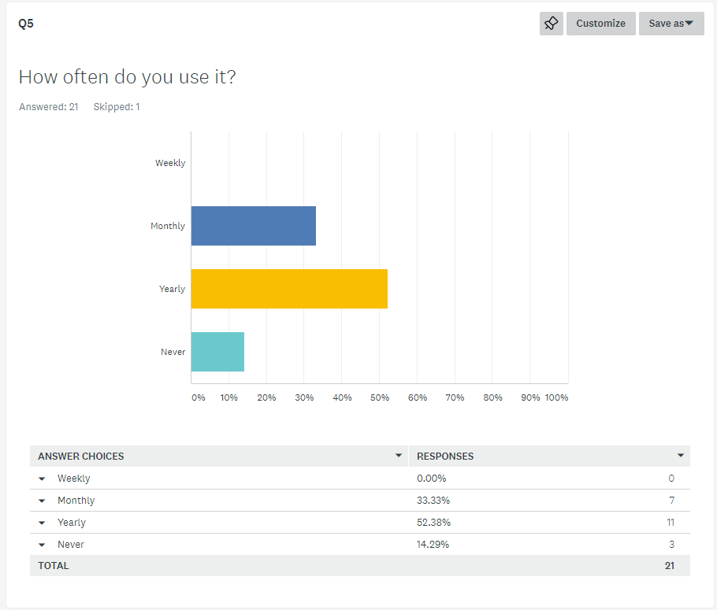

Slide 9
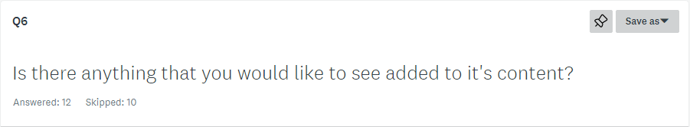
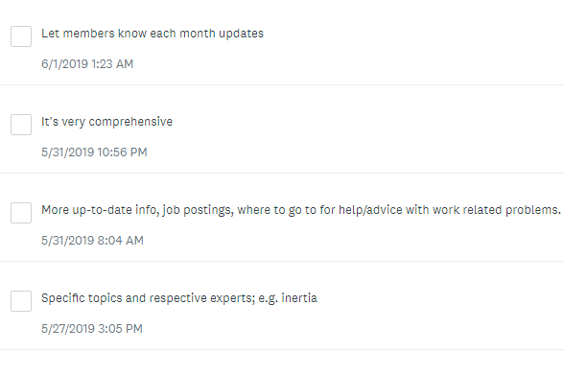

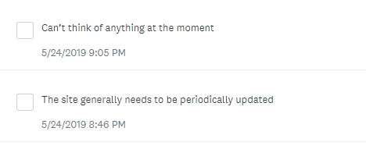
Difference in numbers is due to removal of ‘blanks’ when clipping responses.

Slide 10
SAWE International Communications

Slide 11
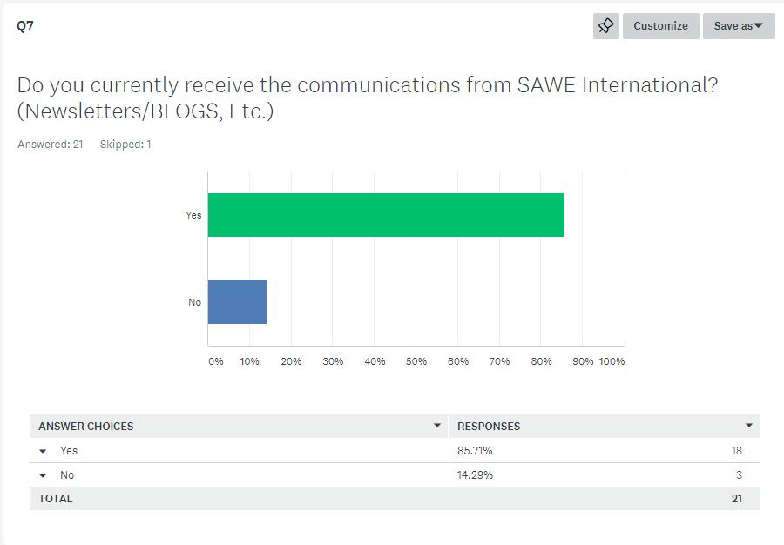

Slide 12
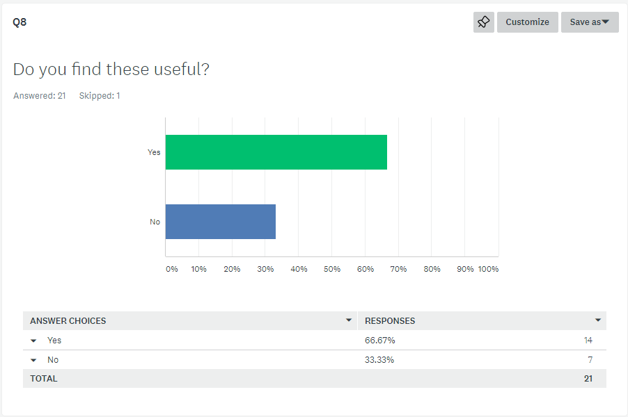

Slide 13
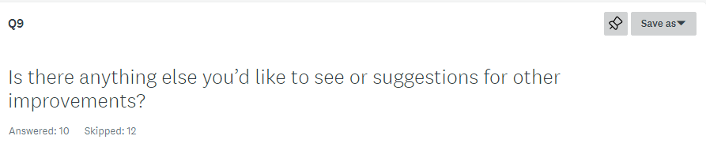
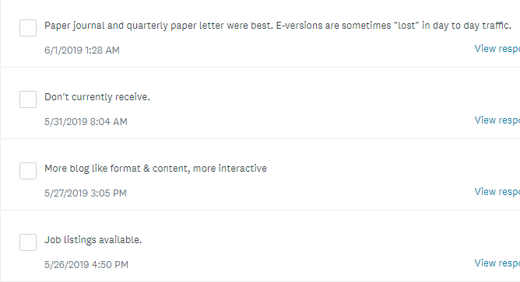


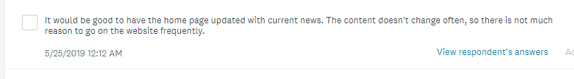
Difference in numbers is due to removal of ‘blanks’ when clipping responses.

Slide 14

Potential Chapter Fall Conference

Slide 15
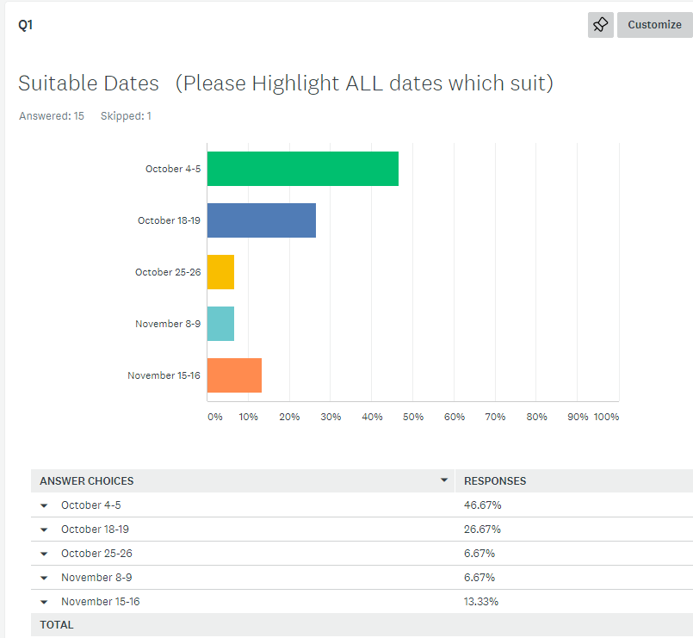

Slide 16
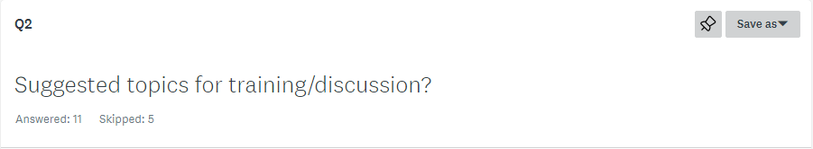
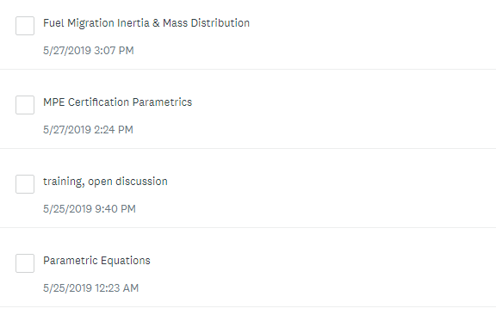
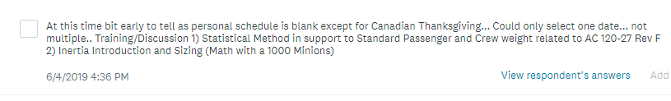

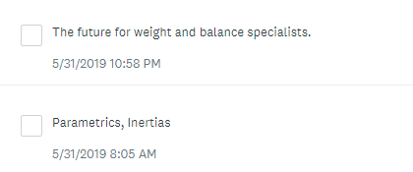
Difference in numbers is due to removal of ‘blanks’ when clipping responses.

Slide 17
Local Social Events

Slide 18
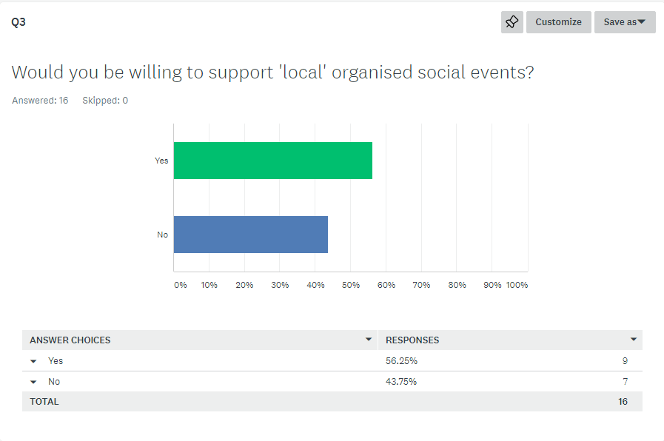

Slide 19
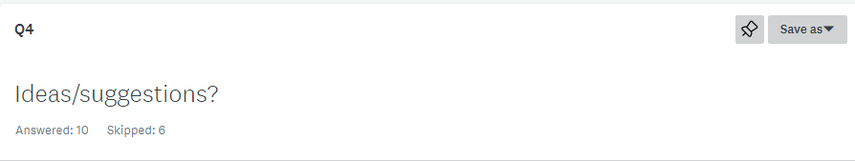
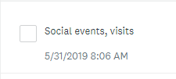
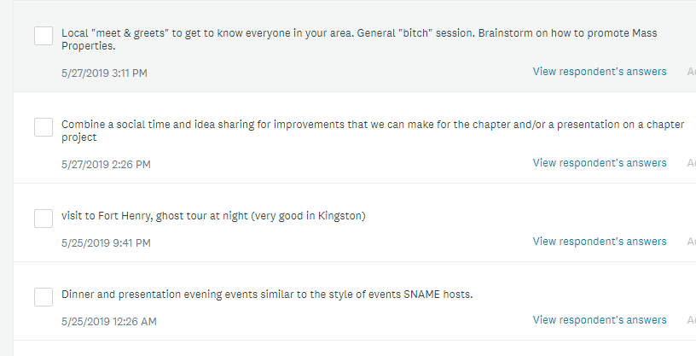
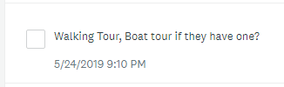
Difference in numbers is due to removal of ‘blanks’ when clipping responses.

Slide 20
