Slide 1
Welcome to the SAWE Southeast Region
A Proud Chapter of the Society of Allied Weight Engineers

Slide 2
Who is SAWE?
We are an International Organization of Mass Properties Engineers founded in 1939
Our Purpose:
To promote the Mass Properties discipline
To provide a medium for exchanging recommended practices based on experience and innovation
To foster technical excellence and superior quality in mass properties prediction, control and validation
22 Chapters in the US, Canada, South America, UK and Europe
18 Corporate Partners and over 500 members

Slide 3
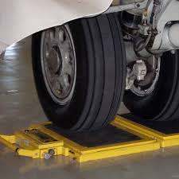
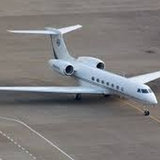
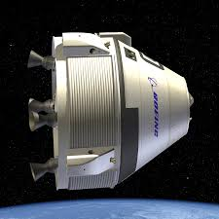
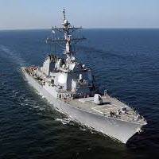
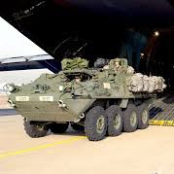
Industries Served by SAWE
Initially - Society of Aeronautical Weight Engineers
1973 - Renamed Society of Allied Weight Engineers to include:
Aerospace – aircraft, missiles, space, electronics, …
Marine – surface, cargo, submarines, …
Offshore Platforms – oil and gas, launch/landing, …
Land Vehicles – automotive, armored, construction, …
Allied Industries – scales, equipment, software, …

Slide 4
SAWE International Leadership Team
Position | Officer | Organization
President | John Hargrave | Northrop Grumman Corporation - Retired
Executive VP | Clint Stephenson | S&K Global Solutions
Senior VP | Errol Oguzhan | Lockheed Martin
VP Publications | Nicholas Marickovich | Huntington Ingalls Industries
VP Technical | Robert Zimmerman | Lockheed Martin - Retired
VP Training | Dan Rowley | Northrop Grumman Corporation
VP Vendor Relations | Paul Kennedy | Space Electronics
VP Internet | Andrew Brooks | Lockheed Martin Aeronautics - Retired
VP Standards & Practices | Douglas Fisher | Collins Aerospace
VP Academic Affairs | Dr. Donna Gerren | University of Colorado Boulder
Executive Director | Bill Boze | Huntington Ingalls Industries

Slide 5
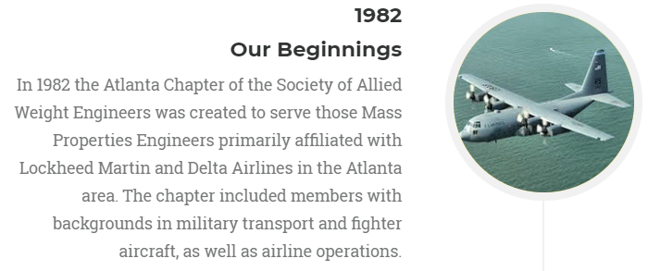
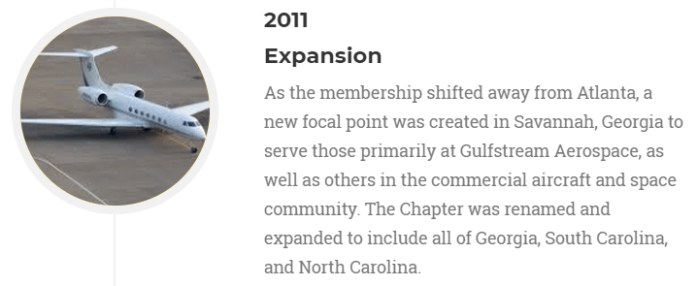
Our Chapter History

Slide 6
Our Chapter Leadership Team

Slide 7
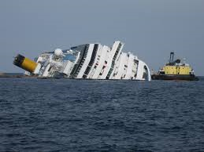
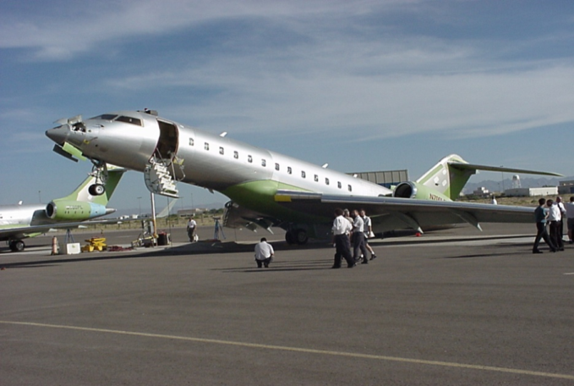
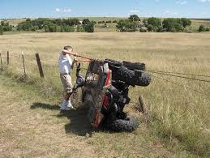
Why is Mass Properties Control important?
Weight, Center of Gravity, Moments and Products of Inertia are critical for vehicle safety and performance

Slide 8
Why is Mass Properties Control important?
Cost of weight growth and balance issues increases dramatically as your programs progress
Opportunity for design change
HIGH
LOW
Cost of design change
Program Lifecycle

Slide 9
Why is SAWE important?
Mass Properties discipline often overlooked
Not specifically in college curriculum even though it is integral to every product and system
Company Management mistakenly thinks CAD can do it all
Inadequate staffing/skills increases program risk
Aging workforce in this crucial discipline
62% retiring over next 10 years*
SAWE provides:
Proven processes and experience for mass properties control
Educational resources for ensuring a skilled workforce
International collaboration between industry and governments
Venue for sharing and discovering new methods and lessons learned
*The Health of Mass Properties Engineering - 2018 Industry Survey

Slide 10
Why should I be a member?
Networking
Collaborate with peers at chapter meetings and regional and international conferences
Mentor the next generation and learn from experts
Discover career opportunities
Make lifelong friendships
Upcoming International Conference Plans
2021 Melbourne, FL
2022 Savannah, GA

Slide 11
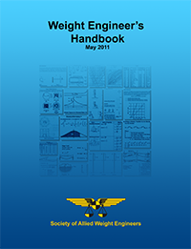
Why should I be a member?
Publications
Members Only access to the premier source for Mass Properties literature
Extensive Library of over 3000 Technical Papers*
3 issues of Weight Engineering Journal per year
SAWE Blog
Discounts for all SAWE publications and textbooks
Free SAWE Handbook (digital) plus updates
Conference Papers and Exhibitor Information provided to Registrants and Corporate Partners
* 10 free downloads/year

Slide 12
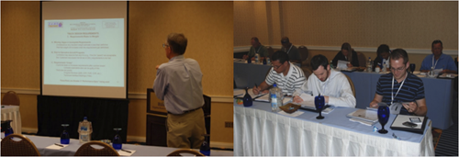
Why should I be a member?
Training
Variety of courses from analytical methods to measurement techniques taught by experts online, onsite, or at conferences
Improve technical capabilities and skills
Classroom
Hands on

Slide 13
Why should I be a member?
Scholarships*
SAWE Scholarship - $1000 (2 awarded/year typically)
Applicants must be high school seniors or graduates who plan to enroll or students who are already enrolled in a full-time undergraduate course of study at an accredited four- year college or university.
Frank Fong Memorial Scholarship - $1000 (1 awarded/year)
Same requirements as above, but applicant must be majoring in a scientific field (e.g. engineering, physics, mathematics, computer sciences, etc.)
Annual Conference Scholarship - $1000 (1 awarded/year)
Chapter Scholarships
Amount determined by individual Chapter
*For student members and children or grandchildren of members active for at least 1 year

Slide 14
Why should I be a member?
Recognition
Awards for advancing the Mass Properties discipline
Best Student Paper Award
Best Student Presentation
Ed Payne Young Engineer Award
L. R. “Mike” Hackney Best Paper Award
Special Merit Award
SAWE Fellow
SAWE Honorary Fellow
SAWE Richard Boynton Lifetime Achievement Award

Slide 15
Why should I be a member?
Leadership Development
SAWE helps you:
Innovate
Create
Solve problems
Make a difference locally and globally!
Numerous opportunities to get involved and lead
Local Chapter Positions
International Officer Positions
Committee Chairs

Slide 16
How does my company benefit?
Skilled Workforce
Mass Properties Engineers properly trained with access to the latest knowledge base
Program risk reduced through proper application of proven processes
Lessons learned passed on to younger generation starting at the college level

Slide 17
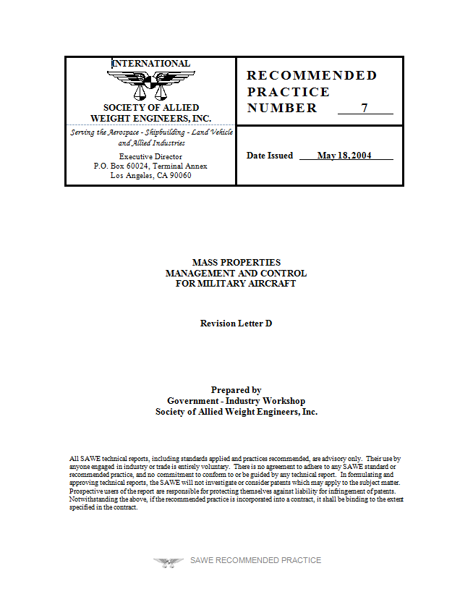
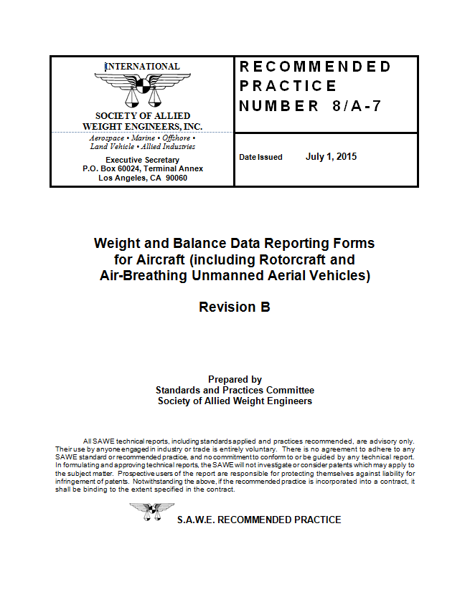
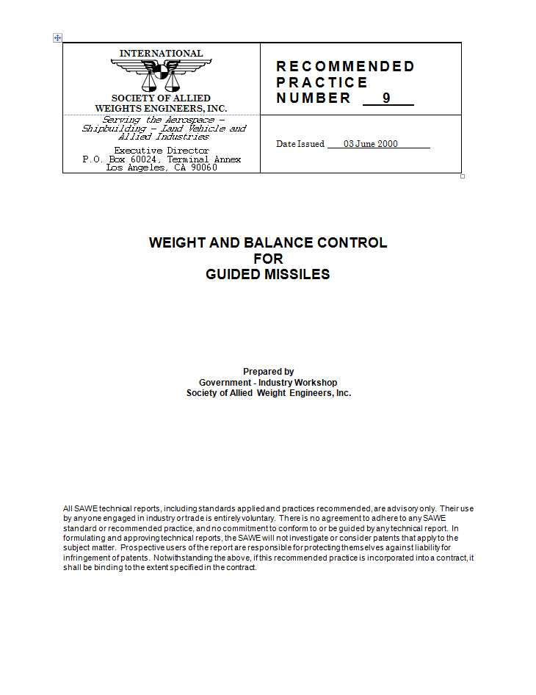
How does my company benefit?
Standards
Gain access to proven recommended practices created through years of SAWE, industry and government collaboration
Help shape these standards
…

Slide 18
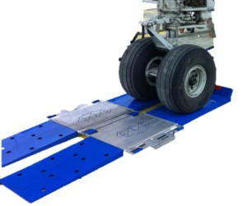
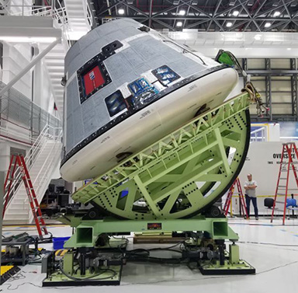
How does my company benefit?
Technology Awareness
Keep abreast of the latest equipment, software and services available
Share your innovations with potential customers / collaborators
…
Courtesy of Altair Engineering, Inc.
Courtesy of General Electrodynamics Corp. GEC
Courtesy of The Boeing Company & Space Electronics, LLC

Slide 19
How much does Membership cost?
Level | Cost
Individual
New Member Member Retired Member Student Member Lifetime | $30/1st year $60/year $30/year Free (pending verification) $900
Special Deal - Gulfstream reimburses half of annual dues for employees!

Slide 20
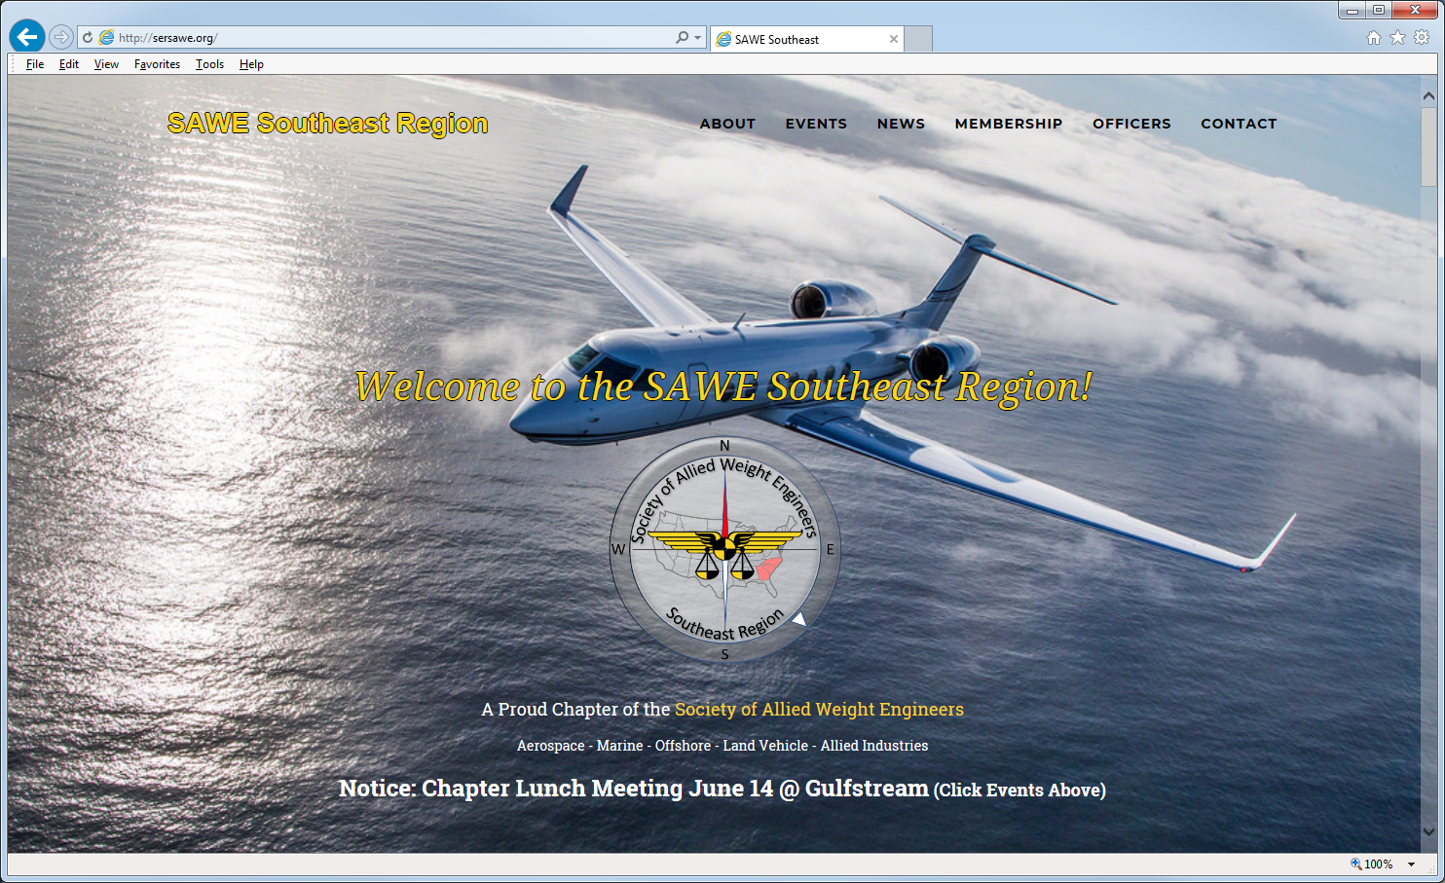
Where can I learn more?
http://www.sersawe.org and https://www.sawe.org

Slide 21
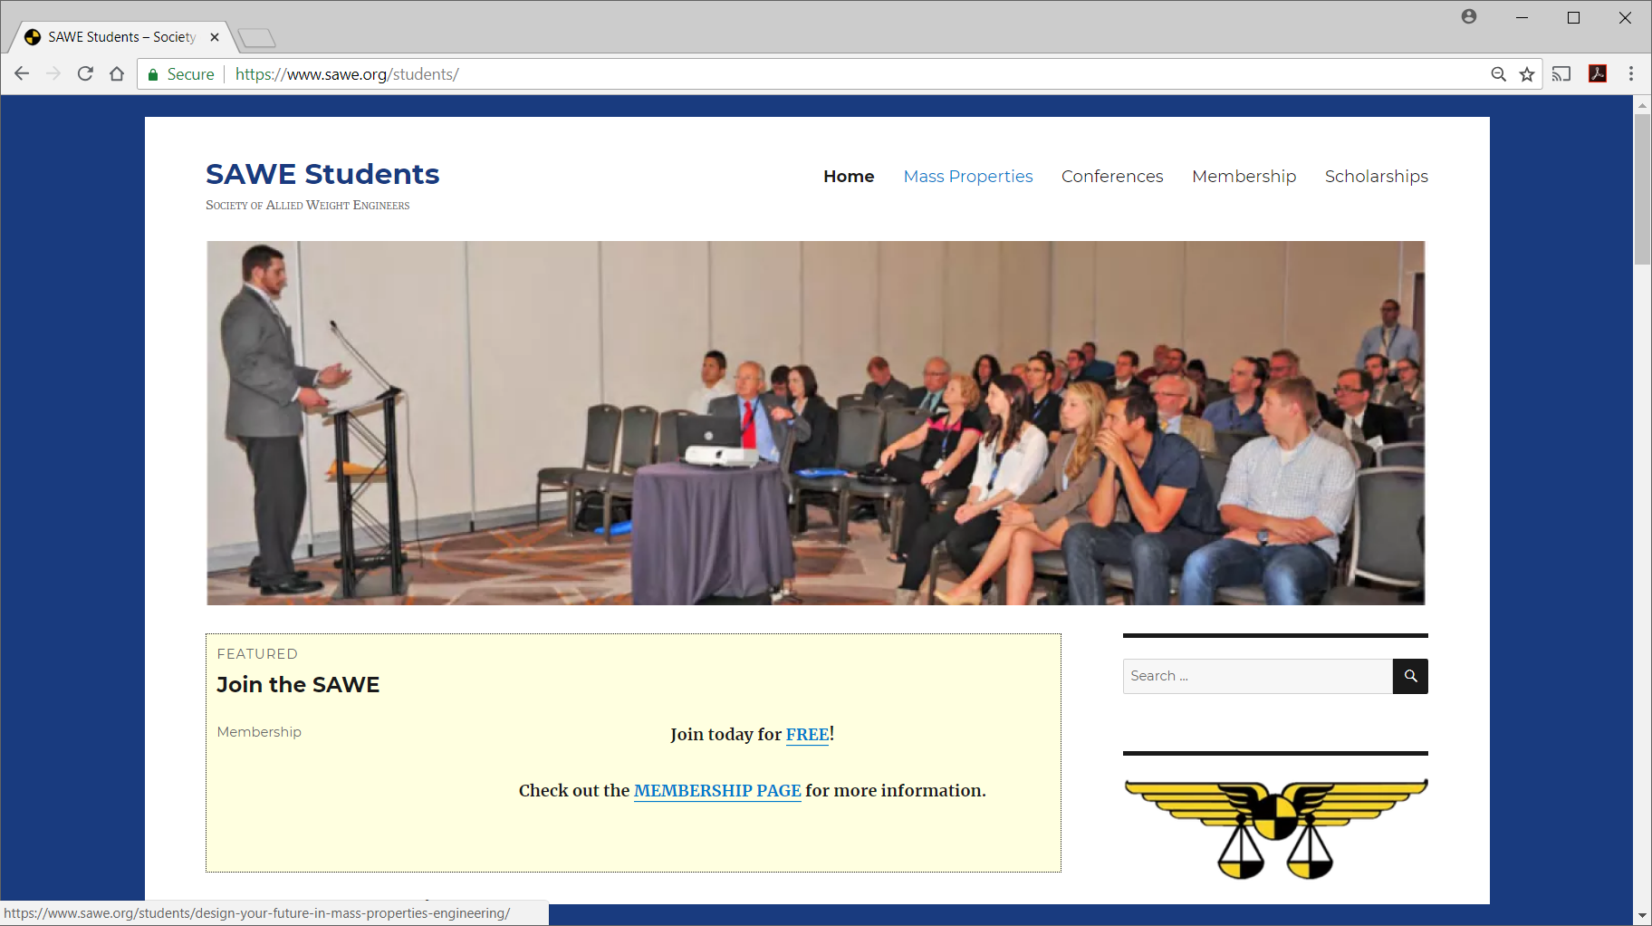
Where can I learn more?
https://www.sawe.org/students/

Slide 22
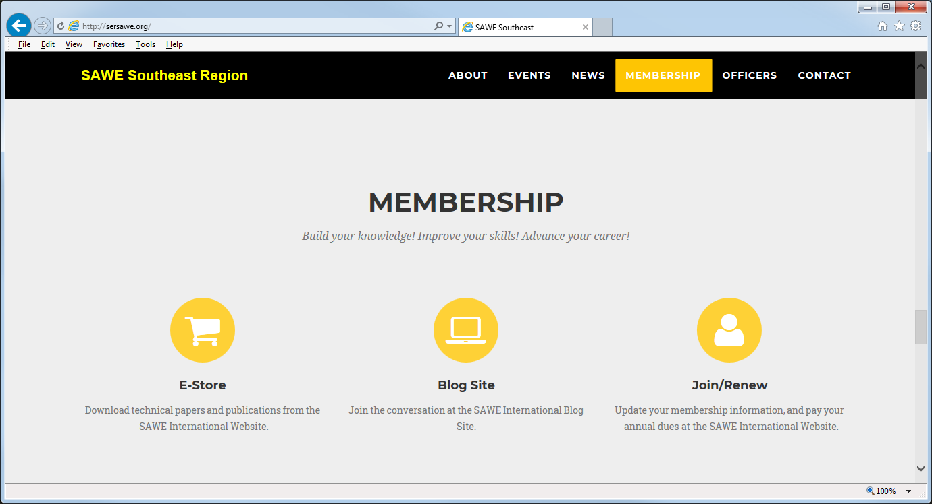
How do I join?

Slide 23
Come and Join Us!
We encourage you to join us at our quarterly meetings
Help us keep our critical discipline alive and well
Write a paper, attend a conference, help with chapter projects
Help Us Help YOU!

