Slide 1
Weight & Mass Properties Engineering for Aircraft Design
Ryerson University
March 17, 2016

Slide 2

Presenters
Vidas (Whidy) Kiskunas Senior Weights Analyst SAWE Fellow Kiskunas, Vidas UTAS Vidas.Kiskunas@utas.utc.com 905-825-1515, ext. 3385 | Whidy Kiskunas is a graduate of Aerospace Engineering Technology, Ryerson Polytechnical Institute (1979). He began his engineering career as a Junior Weights Analyst at McDonnell Douglas Canada Ltd working on major components for the DC-9, MD80, DC-10, MD11, and the F18. In 1990, he joined Bombardier/deHavilland to pursue a career working on the complete aircraft platform. There he supported the Dash series aircraft, Lear45 wing and the Global Express and Global 5000 programs. In 2001, he left Bombardier to become the Senior Weight Analyst for Goodrich Landing Gear which is currently known as UTC Aerospace Systems. He has supported all their business, commercial and military landing gear systems. In all, Whidy has spent the last 35 years working in the field of Mass Properties Engineering. He has also been an active member of the Society of Allied Weight Engineers (SAWE) for over 30 years. During that time he has co-authored a paper, given presentations, received two President Awards, and co-chaired numerous sessions. He is currently serving on the SAWE International Technical Committee. Whidy is one of the founding members of the SAWE Canada Chapter where he has held every executive position.
Notes:
Speaker introduction - Whidy: Describe your background, industry experience, involvement in SAWE, and your reason for being there.

Slide 3

Presenters
Rod van Dyk Senior Mass Properties Engineering Analyst – Safran Director - SAWE Canada rod.vandyk@safranmbd.com 905-683-3100, ext. 1239 | Rod vanDyk is a graduate of Air Transport & Industrial Engineering, Durham College (1990). He began his engineering career as a Junior Mass Properties Analyst at Pratt & Whitney Canada working on the JT15D, PW300, and PW500 turbine engines. In 1995, he joined Bombardier/deHavilland where he supported the Dash series aircraft, and Global Express and Global 5000 programs. He also served as the Q400 flight test loadmaster in Wichita, Kansas (1998-1999). In 2004, he became a Customer Engineer at Bombardier supporting aircraft deliveries and technical lead for potential new customers. Since 2006, Rod has been the Senior Mass Properties Engineering Analyst for Messier-Bugatti-Dowty (Safran) supporting all their business, commercial and military landing gear systems. He has also been an active member of the Society of Allied Weight Engineers (SAWE) for over 20 years. He is the current Director of the SAWE Canada Chapter, and has held every supporting title in the board during that time.
Acknowledgments:
A big thanks to Casey Regan, Evan Visser, and Mishaal Aleem, The Boeing Company, and Chet Nelson, Technical Fellow - The Boeing Company, for helping to plan and compile this material.
Notes:
Speaker introduction - Rod: Describe your background, industry experience, involvement in SAWE, and your reason for being there.

Slide 4
Learning Objective
Gain a deeper understanding of the importance of vehicle weight and mass distribution, as well as the roles and responsibilities of a weight and mass properties engineer
Learn the process for estimating vehicle weight and mass properties as can be applied to senior design project
    Conceptual
    Statistical
    Analytical
Understand how a commercial aircraft Weight and C.G. diagram is developed
Notes:
Rod
Purpose: Explain the expected takeaways from the lecture;
1) that students would learn the background and purpose of SAWE,
2) that students would gain a deeper understanding of the importance and roles of a Weight and Mass Properties Engineer,
3) that students would understand the techniques for estimating weight and C.G., and have useful tools for their senior design projects.
4) Q & A will be available at the end of presentation

Slide 5


Society of Allied Weight Engineers
The Society of Aeronautical Weight Engineers was organized in 1939 in Los Angeles, California
Member companies include aerospace, marine, offshore platforms, land vehicles and allied industries
Name was changed on January 1, 1973 to the Society of Allied Weight Engineers, Inc.
Today there are 23 chapters worldwide with over 750 active members.
One of the purposes is to: [Promote] the inclusion of mass properties engineering in the curriculum of study in institutions of higher learning.
Notes:
Introduction to SAWE: Describe the history of SAWE. Explain that SAWE covers many industries. Talk about the national conference and collaboration between competitors to solve problems.

Slide 6
Basic Weight Definitions
Operational Empty Weight (OEW) – Weight of structure, power plant, furnishings, and systems, plus standard and operational items (personnel, equipment, and supplies necessary to operate the aircraft).
Payload – Weight of passengers, cargo, bags, weapons, or special equipment (determined by Zero Fuel Weight minus OEW).
MTOW
Maximum Zero Fuel Weight (MZFW) – Maximum weight allowed before usable fuel must be loaded in defined sections of the aircraft as limited by strength and airworthiness requirements.
Fuel
MZFW
Maximum Takeoff Weight (MTOW) – Certified maximum weight for takeoff as limited by aircraft strength and airworthiness requirements. (This is the maximum weight at start of takeoff run).
Payload
OEW
S&O
Useful Load – Weight of payload and usable fuel.
Normal Operating Gross Weight (NOGW) – aka Loaded Weight, this is the gross weight for an average real world flight (Example: Airliner at 85% payload, fuel for half range; Fighter with internal fuel and training rounds).
MEW
Notes:
Terminology: Start by describing basic weight definitions.
These are some basic weight definitions common to the aerospace industry; though many more limits exist.

Slide 7
Why is airplane weight important?
Lift Coefficient
Endurance
Weight is a first order driver of flight vehicle performance and cost.
Takeoff Distance
Approach Speed
Rate of Climb
Notes:
Importance of weight: Takeaway: Weight is important as a first order driver of flight vehicle performance and cost.
A higher weight than the minimum for any aircraft generally results in less capability (shorter range, less endurance, higher fuel consumption, longer takeoff & landing, slower climb, etc.)
Minimizing weight and accurate weight tracking is a critical design goal.

Slide 8
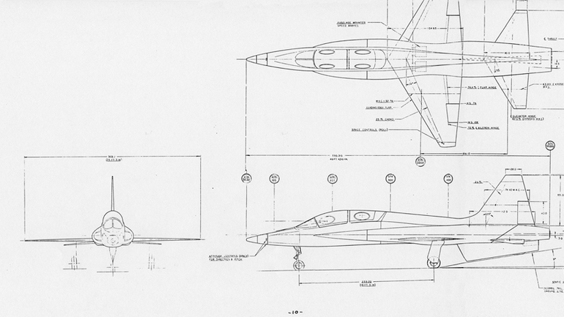
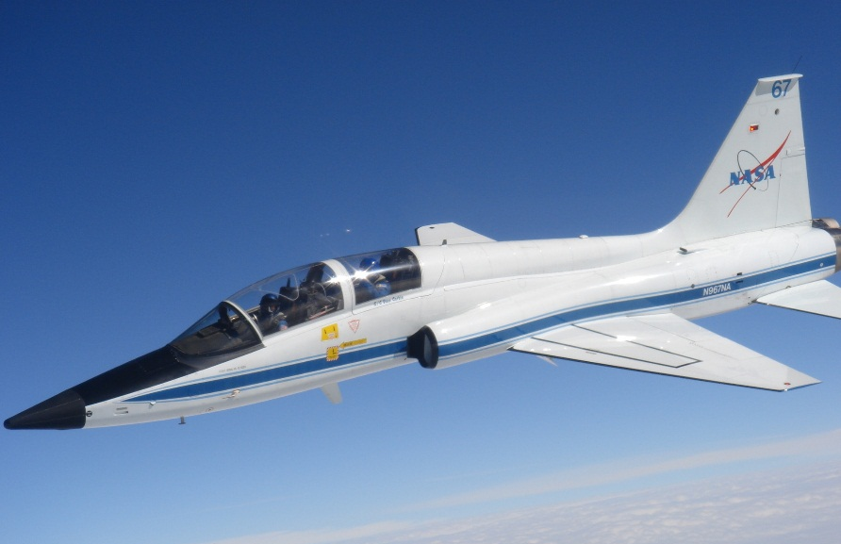
Role of a Weight & Mass Properties Engineer
1) Estimate, calculate, and validate the weight and C.G. of a vehicle
2) Ensure vehicle design is Weight Efficient
3) Actively lead weight reduction efforts to meet weight targets and improve vehicle performance
From initial concept…
…through production.
Notes:
Weight Engineer RAA: Big idea: What are the roles and responsibilities of a Weights and Mass Properties Engineer?
Predict and track the weight and C.G. of a vehicle from concept through delivery.
Ensure a weight efficient design with flexible loading and operational envelope.

Slide 9
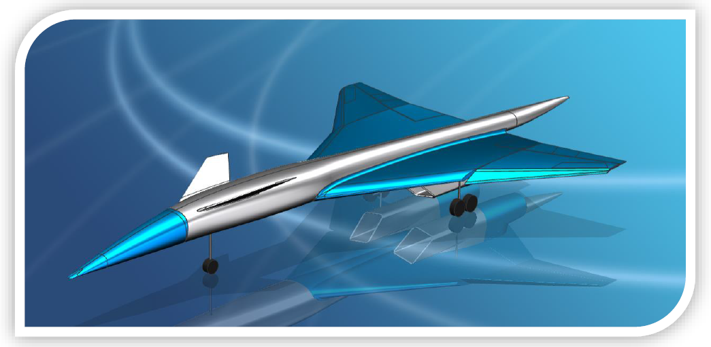
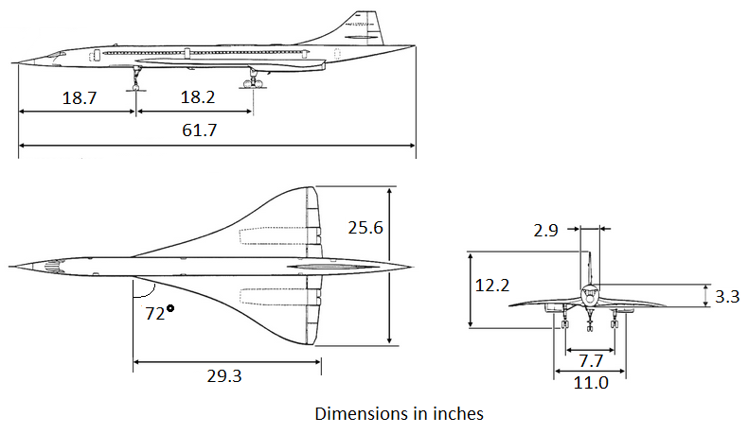
Exercise:
Using the known information from Airplane A (see data table on right), estimate the wing weight of Airplane B shown in the three view below:
Airplane B
Airplane A
Length | 6.1 ft.
Wingspan | 4.3 ft.
Aspect Ratio | 2.5
Wing Ref Area | 7.4 ft^2
Total Weight | 27.0 lb.
Wing Weight | 6.2 lb.
CLmax | 1.2
Max Thrust (static) | 28.6 lb.
Notes:
Answer 1.9 lb.
Calculate lb/ft^2 of Airplane A based on the given data (6.2lb/7.4sqft = 0.84 lb/sqft)
Calculate wing area from three view and convert to square feet. Approximate triangular area. Base: [0.5 * (25.6-2.9) = 11.4 in.]. Area: [(11.4/2 * 29.3) * 2 = 334 sq in. = 2.3 sq ft.]
Multiply by scaling factor. Weight = 0.84 lb/sqft * 2.3 sqft = 1.9 lb.

Slide 10
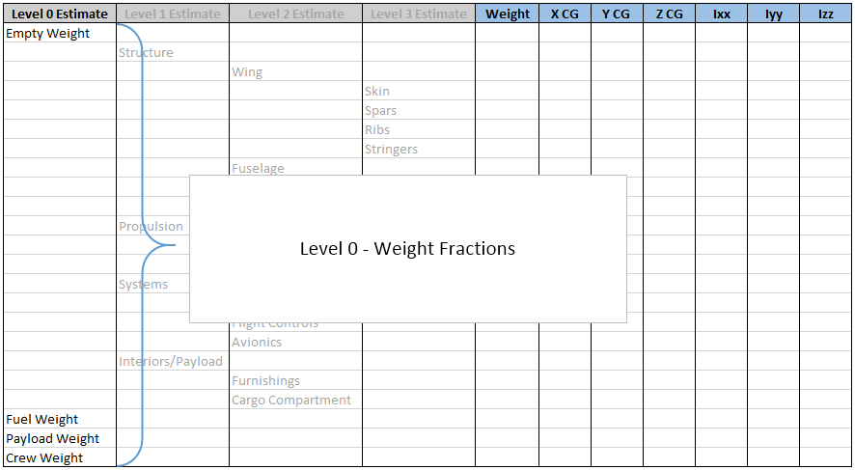
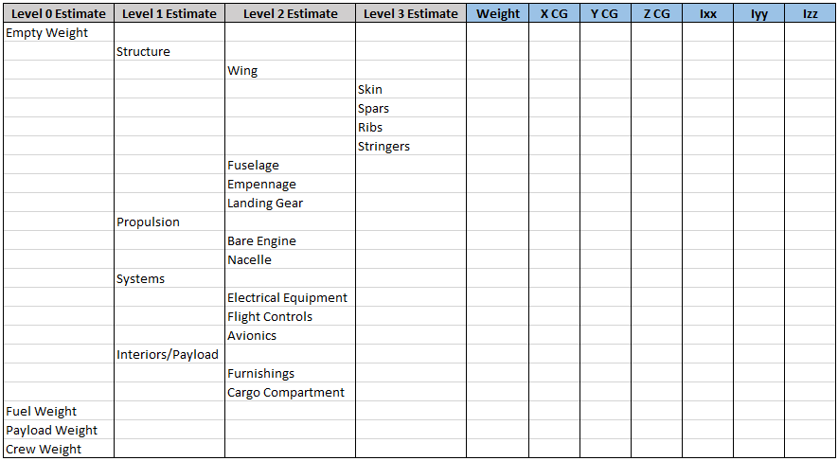
Weight Estimation Process – Level 0
Notes:
Whidy

Slide 11
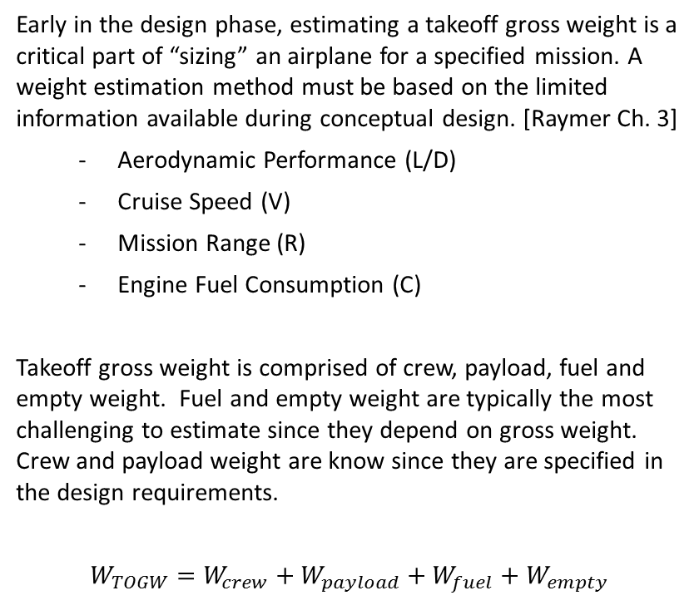
Level 0 – Weight Fractions
Early in the design phase, estimating a takeoff gross weight is a critical part of “sizing” an airplane for a specified mission. A weight estimation method must be based on the limited information available during conceptual design. [Raymer Ch. 3]
  Aerodynamic Performance (L/D)
  Cruise Speed (V)
  Mission Range (R)
  Engine Fuel Consumption (C)
  Takeoff gross weight is comprised of crew, payload, fuel and empty weight. Fuel and empty weight are typically the most challenging to estimate since they depend on gross weight. Crew and payload weight are know since they are specified in the design requirements.
  $$W_{TOGW}=W_{crew}+W_{payload}+W_{fuel}+W_{empty}$$
Specification | Requirement
Passenger Capacity | 175
Cabin Width | > 12.5 feet
Cabin Height | > 7.25 feet
Cargo Capacity | 1240 ft³
Takeoff Distance | 8,200 feet
Alternative Fuels | Biofuels
L/D_{max} | 25% improvement
Seating | Pitch: 32” Width: 17.2”
Landing Speed | < 140 KCAS
Cruise Speed | 0.8
Cruise Altitude | 35,000 feet
Payload Capability | 37,000 pounds
Max Operating Speed | 0.83
Range | 1,200 nominal
Notes:
Conceptual Weight Estimation:
Talk about when it’s used and what kind of accuracy to expect.
Stress that this is a first order weight buildup.

Slide 12
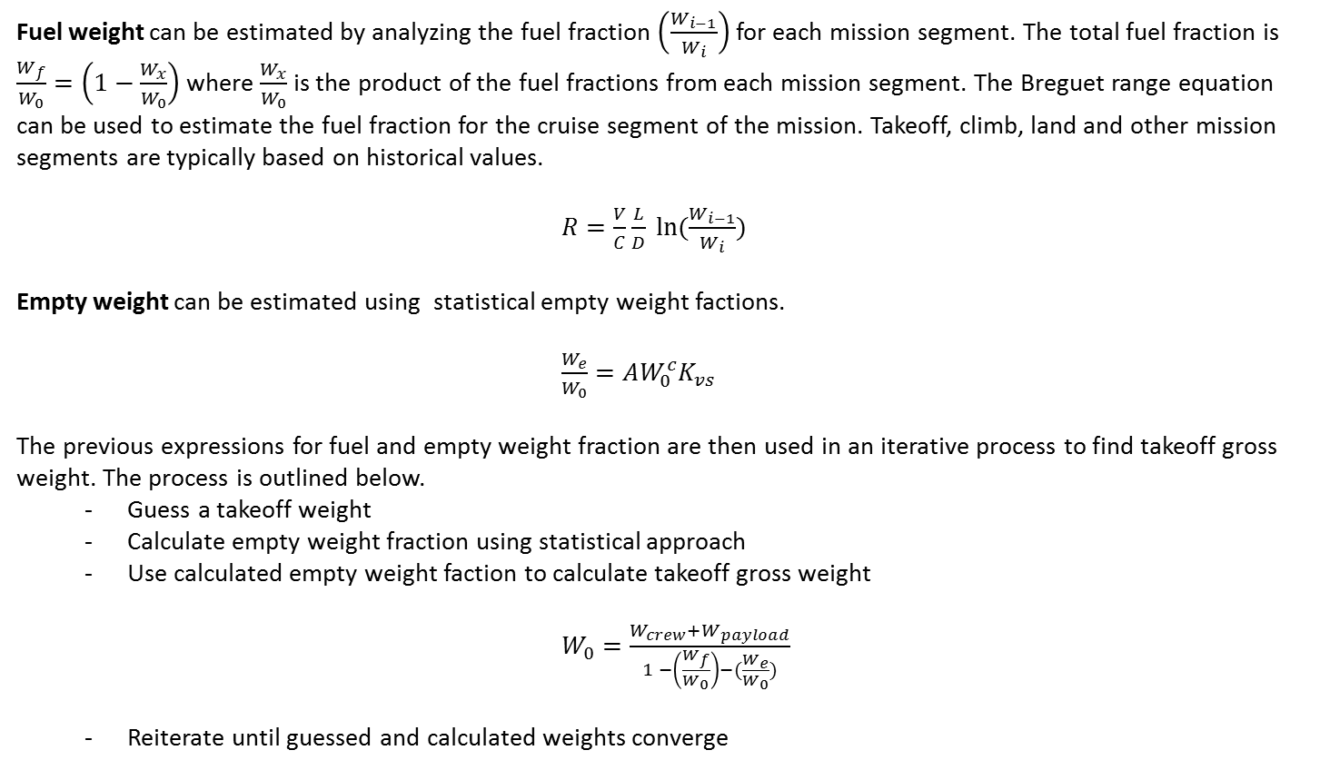
Fuel weight can be estimated by analyzing the fuel fraction $\left(\frac{W_{i−1}}{W_{i}}\right)$ for each mission segment. The total fuel fraction is $\frac{W_{f}}{W_{0}}=\left(1−\frac{W_{x}}{W_{0}}\right)$ where $\frac{W_{x}}{W_{0}}$ is the product of the fuel fractions from each mission segment. The Breguet range equation can be used to estimate the fuel fraction for the cruise segment of the mission. Takeoff, climb, land and other mission segments are typically based on historical values.
  $R=\frac{V}{C}\frac{L}{D} ln⁡(\frac{W_{i−1}}{W_{i}})$
Empty weight can be estimated using statistical empty weight factions.
  $\frac{W_{e}}{W_{0}}=AW_{0}^{c}K_{vs}$
The previous expressions for fuel and empty weight fraction are then used in an iterative process to find takeoff gross weight. The process is outlined below.
  Guess a takeoff weight
  Calculate empty weight fraction using statistical approach
  Use calculated empty weight faction to calculate takeoff gross weight
        $W_{0}=\frac{W_{crew}+W_{payload}}{1 −\left(\frac{W_{f}}{W_{0}}\right)−(\frac{W_{e}}{W_{0}})}$
  Reiterate until guessed and calculated weights converge
  where A, c, and Kvs are statistical constants based on aircraft type and design features.

Slide 13
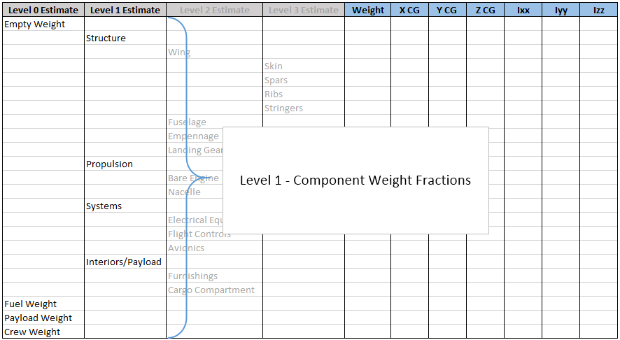
Weight Estimation Process – Level 1

Slide 14
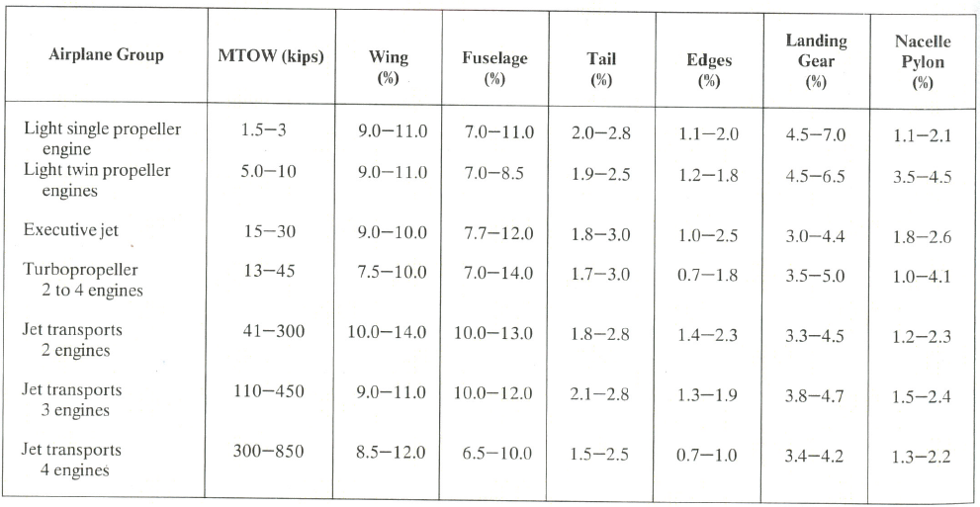
Level 1 – Component Weight Fractions
Notes:
Conceptual Weight Estimation:
Talk about when it’s used and what kind of accuracy to expect.
Stress that this is a first order weight buildup.

Slide 15
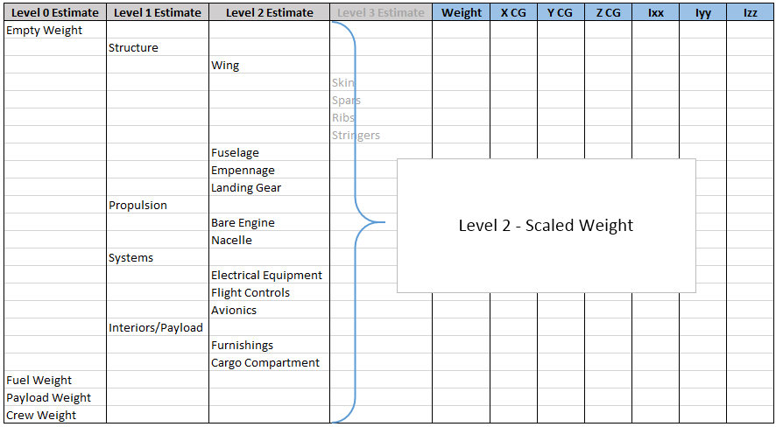
Weight Estimation Process – Level 2

Slide 16
Level 2 – Scaled Weight
As the airplane design progresses, more geometric information becomes available. This allows for a more refined weight estimation using statistical weight equations. [Raymer 15.3]
Regression analysis has been applied to a variety of existing aircraft. These curves can be used to estimate aircraft component weights based on geometric data.
  Note: The accuracy of these curves is limited for a number of reasons. Some of those reasons include data from decades-old aircraft and obsolete technology. Engineering constants (a.k.a. “fudge factors”) can be applied to help account for this.
Since component weights are being calculated, the C.G. estimation can be refined. Assuming the C.G. for each component is at its geometric center is a reasonable first order approximation.
The total weight of the airplane is the sum of the statistically derived component weights.
NOTE: Chart and equation is fictional and does not represent a real airplane.
Notes:
Statistical Weight Estimation:
Talk about the reason this is tough and the lousy data that’s available.
This is typically the first step that industry uses; but these relationships are highly proprietary.

Slide 17
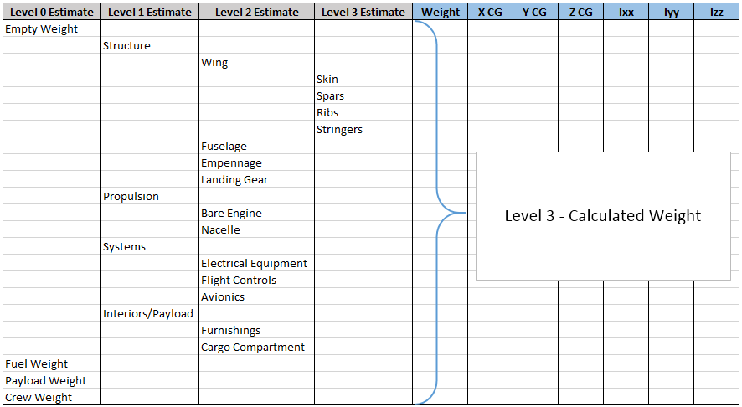
Weight Estimation Process – Level 3

Slide 18
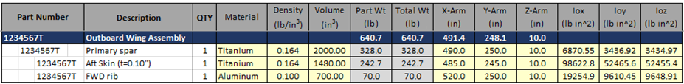
Level 3 – Calculated Weight
Within the various industries, many weight estimation methods are reliant on knowledge of previous and existing aircraft components and designs.
This knowledge provides a myriad of densities, design factors, and load factors to be used when estimating the weight of an aircraft.
As the design of the aircraft becomes more detailed, individual component weights are calculated based on solid volumes and known material densities.
  The detailed component list should include component weight, C.G.’s, and inertias.
  The C.G.’s and inertias are critical for the flight dynamics and stability and control teams to accurately model the aircraft performance and handling characteristics.
NOTE: Table and data is fictional and does not represent a real airplane.
Notes:
Detailed Weight Estimation:
How is it done in industry. Talk about transition from parametric to detailed calculations.
Emphasize the starting point is a known product.

Slide 19
Role of a Weight & Mass Properties Engineer
Weight is the result of the released design & build. To influence the airplane weight, the weight engineer must influence the design & manufacturing process.
Weight = f Requirements + Configuration + Aerodynamics + Loads + Stress + Design + Workforce + …
Mission
Efficiency
Entry into Service
Maintenance
Noise
Cost
Rate
Etc.
3-View
Planform
Body X-Section
Amenities
Integration
New Technology
Build Plan
Etc.
Airfoil Type
Sweep
T/c
Aspect Ratio
Span
Body Closeout
Arearule
Etc.
External
Dynamic Flight
Dynamic Ground
Flutter
Static
In-Flight
  Ground Handling
  Pressure
Wind Milling
Fan Blade Out
  Load Alleviation
Internal
Thermal
Combined
Electrical
Abuse
9G / 16G
Etc.
Strength
Fatigue
Stiffness
Stress Criteria
Min Gage
Margin Policy
Damage
Tolerance
Load
Distribution
Deflection
Etc.
Layouts
Ply Maps
Producibility
Corrosion
Optimization
Tools
Design Growth
Fire Proof
Etc.
Leadership
Staffing Quantity
Skill Mix
Business Model
Etc.
Notes:
Weight Engineer RAA: Big idea: Weight is a function of many, many design parameters. Weight Engineers must be a “jack-of-all-trades” to ensure an efficient design.

Slide 20
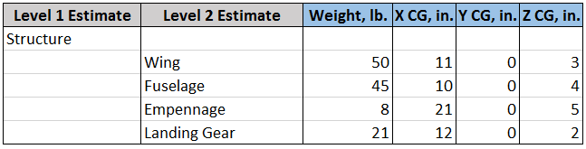
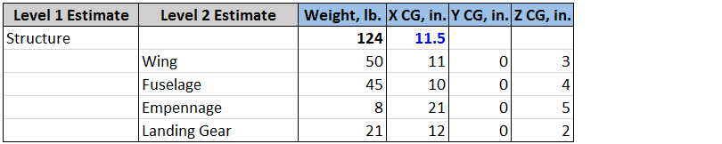
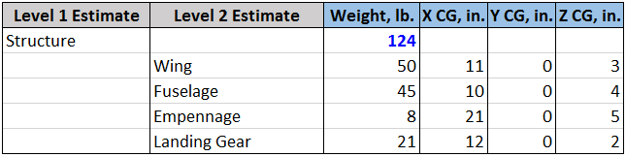
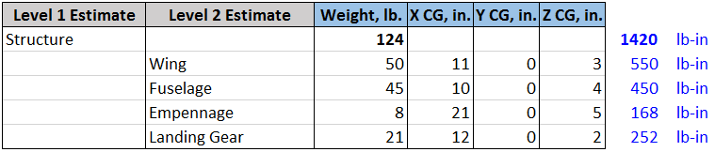
Exercise:
Calculate the longitudinal C.G. of the of the given structure based on the data below.
Notes:
Answer 11.5 in.
Calculate total weight (50+45+8+21 = 124 lb.)
Calculate total longitudinal moment of each component (50*11 + 45*10 + 8*21 + 21*12 = 1420 lb-in)
Calculate structure C.G. by dividing total moment by weight (1420 / 124 = 11.5 in.)

Slide 21

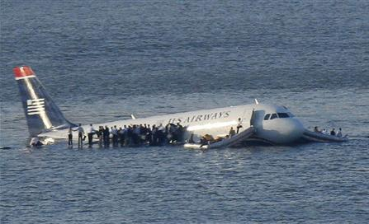
Why is C.G. important?
National Air Cargo 747 Crash
Notes:
Rod
Importance of C.G.: Ask, “Why is center or gravity envelope important to airlines?”
C.G. envelope delineates where an airline can load and operate its airplane.
C.G. imbalances cause increased fuel burn.
C.G. excursions can lead to aircraft damage (tipping) or complete loss of control authority, which is catastrophic (aft load shift).
Ask, “Does anyone know why I’ve included a picture of the A320 in the Hudson River?”
- Talk about ditching and flotation requirements, and the effect of mass properties.

Slide 22
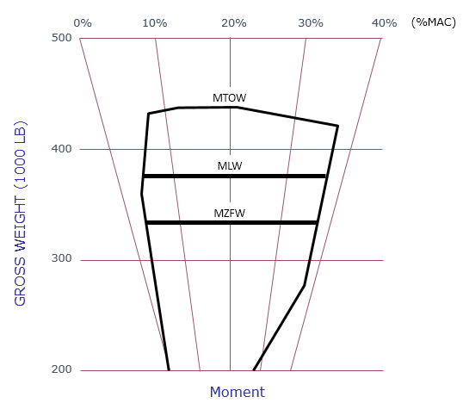
Developing the Weight and C.G. Grid
The forward and aft C.G. limits for a given airplane model are selected during the design of the airplane, and are meant to allow for airline-to-airline variations in:
    Operational Empty Weights
    Interior Seating Arrangements
    Cargo Loading – Bulk, Pallets, Containers
    Fuel Loading and Usage
    Operational Curtailments
The airplane structure and layout is then designed to allow for loading of the airplane within these selected (and eventually certified) limits.
Notes:
The main things to say:
These are the things we try to account for while establishing a set of design C.G. limits.
Objectives:
We don’t always meet the design objectives. We have to compromise on occasion, depending on the nature of the airplane configuration.
The required limits don’t necessarily represent how the airlines will operate the airplane. However, what we want is a consistent set of rules to use across a broad range of airplane models.
Appreciate that this occurs years before the a/p is actually built, so we have to do our best to guess what the requirements are.
This discussion focuses on passenger a/p’s. But, the C.G. limits are the same for freighters. We don’t re-calc them; they are a fall-out of what we design for pax models.

Slide 23
Weight vs. Moment C.G. Grid
0%
10%
20%
30%
40%
(%MAC)
500
400
GROSS WEIGHT (1000 LB)
300
200
Moment
Notes:
Weight vs. Moment C.G. Grid
It’s useful to plot the center of gravity on a weight versus moment fan chart. Each fan line is a line of constant %MAC (mean aerodynamic chord).
The “datum” is the %MAC location where the moment = 0. This point is chosen; in this chart, we use the datum at 20% MAC.
Given: OEW, C.G.

Slide 24
AIRPLANE EMPTY WEIGHT & C.G.
0%
10%
20%
30%
40%
(%MAC)
500
400
GROSS WEIGHT (1000 LB)
300
Most Aft OEW C.G. to consider based on tri-class
Most FWD OEW C.G. to consider based on dual-class
OEW
200
Moment
Notes:
Plot Most Fwd & Aft C.G.
The starting point is an assumed, nominal OEW, and a range of associated empty weight C.G.’s that accommodate expected airline configuration variations relative to this nominal OEW.
The forward C.G. starting point is typically based on a single or dual class configuration while the aft is based on a dual or tri configuration depending on the airplane (single-aisle or twin-aisle).

Slide 25
AIRPLANE WEIGHT & C.G.
WITH PASSENGERS
0%
10%
20%
30%
40%
(%MAC)
500
Assumed
Dual-class loading
400
Assumed
Tri-class loading
GROSS WEIGHT (1000 LB)
300
Chosen as most “reasonable” Aft C.G. to consider based on tri-class with some business seats filled
(rare to have business and first empty with economy full)
DC
Most FWD C.G. to consider based on loading dual-class
TC
OEW
200
Moment
Notes:
Load Passengers
Next, the passengers are seated. On a twin-aisle airplane a tri-class interior will typically result in the most aft C.G. configuration.
On a twin-aisle airplane a dual-class interior will typically result in the most forward C.G. configuration.
Judgment is also used during this process. For example, experience has shown that nobody flies around in a tri-class configuration with the economy section full and both business and first class completely empty.
These loading vectors assume loading of all passengers in a given class at the centroid of the seating area for that class.

Slide 26
AIRPLANE WEIGHT & C.G.
WITH PASSENGERS and CARGO
0%
10%
20%
30%
40%
(%MAC)
500
Most Aft C.G. to consider based on loading pax and baggage
400
Most FWD C.G. to consider based on loading pax and cargo
GROSS WEIGHT (1000 LB)
Assumed cargo loading forward
300
Assumed cargo loading aft
OEW
200
Moment
Notes:
Load Cargo
Now we will load the cargo starting at the extremes that will be considered from the passenger loading envelopes.
First the forward and aft cargo compartments are filled starting at the most forward pax loading point considered.
Then again, but starting at the most aft pax loading point considered. We will again use some judgment, and not assume the complete loading of only one compartment. We will assume the cargo load can be evenly distributed between the forward and aft.
Similar to passengers, these loading vectors assume all cargo in a given compartment is loaded at the centroid of that compartment.
The most aft point considered has loaded only bags. We will see that this is actually further aft than selecting the full cargo point.

Slide 27
AIRPLANE WEIGHT & C.G.
WITH PASSENGERS, CARGO & FUEL
0%
10%
20%
30%
40%
(%MAC)
500
400
Loading center tank fuel
GROSS WEIGHT (1000 LB)
Loading main tank fuel
300
OEW
200
Moment
Notes:
Load Fuel
Finally consider the fuel vector for the airplane starting at the extremes of the pax seating and cargo loading that we are going to consider.
The fuel vector on a jet transport with two mains and a center section is typically based on loading main tank fuel initially. The main tank fuel is located in the wings. The swept wing, in conjunction with the dihedral found on most jet airplanes, results in the C.G. moving aft while the fuel is being loaded into the wing.
The center tank is typically loaded next. The center tank is located in-between the wings in the center section of the airplane. As fuel is loaded into the center tank the C.G. typically moves forward.
Changes in C.G. during burning of the fuel follows just the opposite sequence as that of loading.

Slide 28
AIRPLANE WEIGHT & C.G.
WITH PASSENGERS, CARGO & FUEL
0%
10%
20%
30%
40%
(%MAC)
500
Required C.G. Range to cover assumed loading variations
400
GROSS WEIGHT (1000 LB)
300
OEW
200
Moment
Notes:
This now defines the required C.G. range for passenger, cargo, and fuel loading.
Question: “Why is the red dashed line outside the limit?”
Answer: The red line represents loading on the ground, not in flight.

Slide 29
AIRPLANE WEIGHT & C.G.
WITH PASSENGERS, CARGO & FUEL
0%
10%
20%
30%
40%
(%MAC)
500
Estimate curtailments airlines will use to account for differences between calculated and actual C.G. due to:
400
GROSS WEIGHT (1000 LB)
Gear and flap movement
Movement of pax, crew and service carts during flight
Movement between potable water and waste tanks
Differences between calculated and actual C.G. location of passengers, cargo, and fuel
Estimated forward curtailments
Estimated aft curtailments
300
OEW
200
Moment
Notes:
Establish Curtailments (factor of safety)
Now we account for the fact that operators will be adding curtailments to the certified limits. We want to provide the loading capability we have determined from the previous slides even after curtailments have been applied.

Slide 30
0%
10%
20%
30%
40%
(%MAC)
500
Required C.G. Range to cover assumed loading variations plus possible curtailments
400
GROSS WEIGHT (1000 LB)
300
OEW
200
Moment
Notes:
This produces the final required C.G. range to consider.

Slide 31
0%
10%
20%
30%
40%
(%MAC)
500
MTOW
400
MLW
GROSS WEIGHT (1000 LB)
MZFW
300
OEW
200
Moment
Notes:
Certified Maximum Weights
Next, we add the critical weights like Maximum Takeoff Weight, Maximum Landing Weight and Max. Zero Fuel Weight and this defines the weight – C.G. envelope to which we could design the airplane.
However, designing the airplane to operate within this complete C.G. range at all weights up to MTOW would result in a heavy, and inefficient airplane.

Slide 32
0%
10%
20%
30%
40%
(%MAC)
500
Constant
Wing Load
MTOW
400
MLW
GROSS WEIGHT (1000 LB)
MZFW
300
OEW
200
Moment
Notes:
Plot Constant Wing Loading
We now must add design limits, like the structural limit of the wing.
This constrains the Weight vs. C.G. envelope somewhat; the corners of this desired envelope are cut off based on practical design considerations meant to reduce costs and decrease airplane empty weight.
Decisions on these design choices are influenced by structural considerations, performance requirements, necessary handling qualities, and many other compromises.

Slide 33
The strength of the wing’s structure can impose a limitation on the forward C.G. limits.
The load on the wing is increased both by increasing airplane weight, and by forward movement of the center of gravity. Eventually, the wing’s limits are reached.
Lift _{Wing}
Lift _{Tail}
Weight
WING LOAD
For the airplane to be in equilibrium, the sum of the moments about the tail must = 0:
M _{Tail} = W (B.A._{Tail} – B.A._{C.G.}) – L _{Wing}(B.A._{Tail} – B.A._{Wing}) = 0
L _{Wing} = W (B.A._{Tail} – B.A._{C.G.})
(B.A._{Tail} – B.A._{Wing})
Notes:
Constant Wing Loading
Start by calculating the moment about the tail. In flight, the sum of these moments must be zero for the airplane to be in equilibrium.
The load on the wing is increased both by increasing airplane weight, and by forward movement of the center of gravity. Eventually, the wing’s limits are reached.
If we could reduce the wing loads we could reduce weight in the wing structure.

Slide 34
0%
10%
20%
30%
40%
(%MAC)
500
MTOW
400
MLW
GROSS WEIGHT (1000 LB)
MZFW
Constant Tail Load
300
OEW
200
Moment
Notes:
Plot Constant Max Horizontal Tail Loading
- Similarly, we’ll consider the constraint of a constant, maximum load on the horizontal tail.

Slide 35
The strength of the tail and aft body structure can impose a limitation on the forward C.G. limits.
The load on the tail and aft body is increased both by increasing airplane weight, and by forward movement of the center of gravity. Eventually, the tail or aft body’s limits are reached.
Lift _{Wing}
Lift _{Tail}
Weight
TAIL LOAD
For the airplane to be in equilibrium, the sum of the moments about the wing must = 0 :
M _{Wing} = W (B.A. _{Wing} – B.A. _{C.G.}) – L_{Tail} (B.A._{Tail} – B.A._{Wing}) = 0
L_{Tail} = W (B.A. _{Wing} – B.A. _{C.G.})
(B.A._{Tail} – B.A._{Wing})
Notes:
Constant Tail Loading
Start by calculating the moment about the wing. In flight, the sum of these moments must be zero for the airplane to be in equilibrium.
The load on the tail and aft body is increased both by increasing airplane weight, and by forward movement of the center of gravity. Eventually, the aft body limits or horizontal tail limits are reached.
The down tail load is a big driver in airplane design, influencing aft body loads, horizontal tail loads, trim drag, wing design.

Slide 36
0%
10%
20%
30%
40%
(%MAC)
500
Constant NLG Load
MTOW
400
MLW
GROSS WEIGHT (1000 LB)
MZFW
300
OEW
200
Moment
Notes:
Plot Constant Max Horizontal Tail Loading
- Similarly, we’ll consider the constraint of a constant, maximum load on the horizontal tail.

Slide 37
The strength of the nose gear structure can impose a limitation on the forward C.G. limits.
The load on the NLG is increased both by increasing airplane weight, and by forward movement of the center of gravity. Eventually, the NLG limits are reached.
Load _{NLG}
Weight
Load _{MLG}
NOSE LANDING GEAR LOAD
For the airplane to be in equilibrium, the sum of the moments about the main landing gear must = 0:
M _{MLG} = W (B.A. _{MLG} – B.A. _{C.G.}) – L_{NLG} (B.A. _{MLG} – B.A. _{NLG}) = 0
L_{NLG} = W (B.A. _{MLG} – B.A. _{C.G.})
(B.A. _{MLG} – B.A. _{NLG})
Notes:
Maximum Nose Gear Load
Start by calculating the moment about the main landing gear.
The load on the NLG is increased both by increasing airplane weight, and by forward movement of the center of gravity. Eventually, the NLG limits are reached.
Usually the load on the nose gear is only 10% or less of the airplane’s total weight.

Slide 38
0%
10%
20%
30%
40%
(%MAC)
500
Constant MLG Load
MTOW
400
MLW
GROSS WEIGHT (1000 LB)
MZFW
300
OEW
200
Moment

Slide 39
The strength of the main landing gear structure can impose a limitation on the aft C.G. limits.
The load on the MLG is increased both by increasing airplane weight, and by aft movement of the center of gravity. Eventually, the MLG limits are reached.
Load _{NLG}
Weight
Load _{MLG}
MAIN LANDING GEAR LOAD
For the airplane to be in equilibrium, the sum of the moments about the nose landing gear must = 0:
M _{NLG} = L_{MLG} (B.A. _{MLG} – B.A. _{NLG}) – W (B.A. _{C.G.} – B.A. _{NLG}) = 0
L_{MLG} = W (B.A. _{C.G.} – B.A. _{NLG})
(B.A. _{MLG} – B.A. _{NLG})
Notes:
Maximum Main Gear Load
Start by calculating the moment about the nose landing gear.
The load on the MLG is increased both by increasing airplane weight, and by aft movement of the center of gravity. Eventually, the MLG limits are reached.

Slide 40
0%
10%
20%
30%
40%
(%MAC)
500
MTOW
400
MLW
GROSS WEIGHT (1000 LB)
MZFW
Takeoff Tip-Up
300
OEW
200
Moment
Notes:
Takeoff Tip-Up
Some constraints are not due to structural limitations, but instead limitations imposed due to controllability of the airplane.
The takeoff tip-up restriction ensures there will be sufficient nose wheel steering effectiveness.

Slide 41
At takeoff (full thrust, static airplane) there is a possibility of reduced nose gear steering effectiveness or actual airplane tip-up.
The load on the NLG is reduced by: decreasing airplane weight, aft movement of the C.G., and increasing thrust. At light enough NLG loads, steering effectiveness is reduced, and eventually, the NLG load can become negative causing the airplane to tip up.
Thrust
Δh
Load _{NLG}
Weight
Load _{MLG}
BRAKE RELEASE TIP-UP
For the airplane to be in equilibrium, the sum of the moments about the main landing gear must = 0 :
M _{MLG} = W (B.A. _{MLG} – B.A. _{C.G.}) – TΔh – L_{NLG} (B.A. _{MLG} – B.A. _{NLG}) = 0
L_{NLG} = W (B.A. _{MLG} – B.A. _{C.G.}) – TΔh
(B.A. _{MLG} – B.A. _{NLG})
Notes:
Takeoff Tip-Up Limit
Start by calculating the moment about the main landing gear.
The load on the NLG is reduced both by decreasing airplane weight, and by aft movement of the C.G., and increasing thrust.
Low-speed steering is with nose-gear wheel, whereas high-speed steering is with rudder. If you lose NG steering before moving fast enough for rudder steering to work you can lose control of the airplane.
Like a rudder on a boat, airflow over rudder must be enough that rudder can supply enough control force.
This only applies to a/p’s with underwing engines.
Actually, the analysis is much deeper than this simple look. It involves moment of inertia in the yawing axis.
Torque = (moment of inertia) (angular acceleration)
Moment of inertia increases as weight moves further from axis of rotation.

Slide 42
AIRPLANE WEIGHT & C.G.
WITH PASSENGERS, CARGO & FUEL
0%
10%
20%
30%
40%
(%MAC)
500
Constant NLG Load
Constant Wing Load
Constant MLG Load
MTOW
400
MLW
GROSS WEIGHT (1000 LB)
Constant Tail Load
MZFW
Takeoff Tip-Up
300
OEW
200
Moment
Notes:
If we add these all together…

Slide 43
Final Certified Structural Envelope
0%
10%
20%
30%
40%
(%MAC)
500
MTOW
400
MLW
GROSS WEIGHT (1000 LB)
MZFW
300
200
Moment
Notes:
Final Certified Structural Weigh & C.G. Envelope
We finally end up with the legal weight – C.G. envelope which is documented in the Airplane Flight Manual and Weight and Balance manual.
The airplane must be loaded in such a way that from engine start to engine shut-down these legal limits are not exceeded.
Boeing must then design the aircraft to handle all loads within this certified weight/C.G. envelope. In addition, the aircraft’s performance and handling characteristics must be proven to be acceptable when operated within these limits.

Slide 44
Final Certified Structural Envelope
0%
10%
20%
30%
40%
(%MAC)
500
MTOW
400
MLW
Ground Stability Limit
GROSS WEIGHT (1000 LB)
MZFW
Aft Tipping Limit
300
200
Moment
Notes:
Additional Considerations – Ground Handling
There are a few additional limitations that are outside of the certified envelope.
Two of these are the tipping limit and the ground stability limit (static).
These lines are really just special case lines on constant nose gear load, namely a line of constant 0.0 lb. nose gear load.

Slide 45
Weight Estimation: Engineering Approach
For the senior design project’s aircraft build, it is recommended to compile a list of possible materials and their respective densities. Much of this information is available in prior years’ reports.
  For material information not already available, acquire test articles and generate data.
  A readily available list of material properties will allow the weight estimates of aircraft components to occur alongside the design process. It will also aide in more accurate design and build process trades.
It is recommended to generate a component list early on in the design process. Initially, only high level details will be known, but sub details are easily added as the design matures.

Slide 46
Weight Estimation: Engineering Approach
Recommendations for UAW weight and C.G. estimation:
  Build a baseline set of data
    Measure previous years’ components and generate high level areal densities (wing, tail, electronics, engines, etc.) This will allow you to reasonably estimate level 2+ parts.
  Apply delta weights and C.G.’s as better data is determined
  - As parts are ordered or built, incorporate actual weights into weight tracking sheet.
  Lessons Learned from past years: create a method to easily check the aircraft’s C.G. in the field prior to flight.

Slide 47
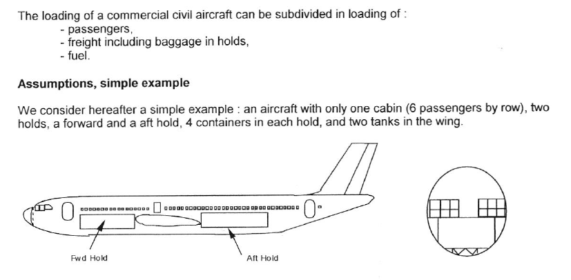
Aircraft Loading
Notes:
Whidy ---- Reference SAWE Paper 3302 –

Slide 48
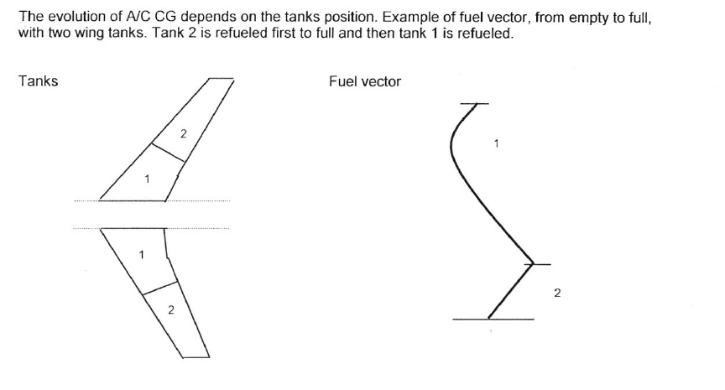
Fuel Loading

Slide 49
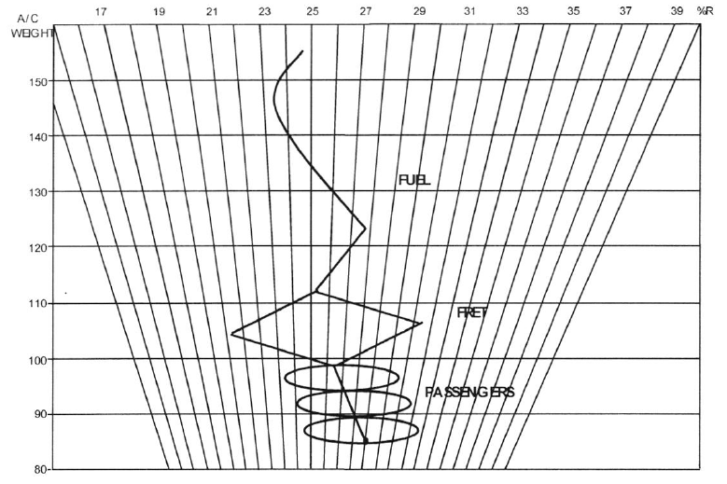
CG Diagram

Slide 50
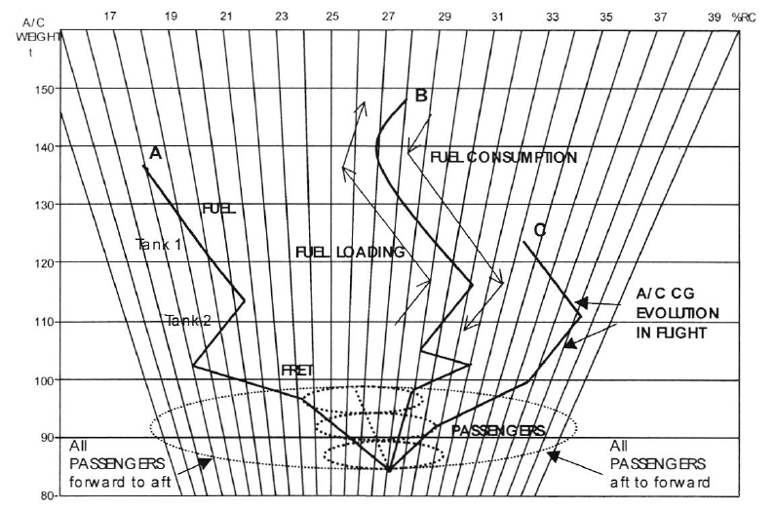
CG Variation

Slide 51
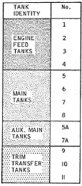
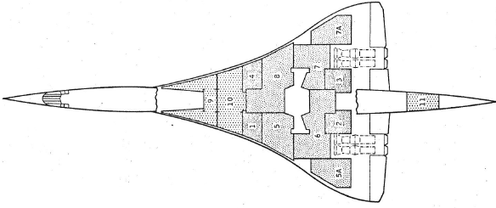
Concorde Weight & Balance

Slide 52
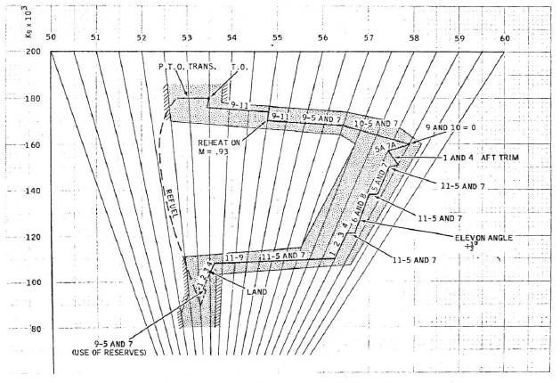
Fuel consumption and transfers in flight (typical flight)

Slide 53
Landing and Braking Systems
http://www.safran-group.com/video/4068
Notes:
Rod to present this video on behalf of Safran Landing Gear Systems

Slide 54
Landing Gear Design Considerations
Identify and list the landing gear design requirements. It is recommended to consult references such as [12] and [3].
Select landing gear configuration (e.g. tricycle, tail gear, bicycle, quadricycle, multi bogey)
Select fixed, or retractable, or partially retractable
Determine aircraft forward and aft center of gravity (assume no landing gear at this moment)
Calculate landing gear height, based on ground clearance requirements
Determine the distance between main gear and aircraft most forward center of gravity
Determine the distance between main gear and aft center of gravity
Check tip-back (or tip-forward if tail gear) requirement.
Check the take-off rotation clearance requirement
Calculate wheel base
Determine wheel track (distance between left and right wheels of main gear) in lateral axis
Notes:
Whidy to present this section

Slide 55
Landing Gear Design Considerations
Determine landing gear attachments
If retractable, determine where the landing gear is going to be retracted (e.g. inside wing, inside fuselage)
Determine aircraft forward and aft center of gravity when the landing gear weight is added to the aircraft weight
Check overturn angle requirement
Investigate structural integrity
Investigate aircraft ground clearance requirement
Investigate aircraft ground stability
Investigate aircraft ground controllability
Check other design requirements (e.g. cost, maintainability, and weight)
If any of the design requirements is not satisfied, return to the relevant design step and recalculate the corresponding parameter

Slide 56
Landing Gear Design Considerations
If any landing gear parameters is changed, the entire landing gear needs to be revisited and revised
Determine the load on each gear
Size wheels and tires
Design the struts
Design the shock absorber
Design gear retracting mechanism
Optimize
Draw the final design for the landing gear
For other aircraft configurations (e.g. sea-plane) or other landing gear configurations (e.g. bicycle), the reader needs to revise the above-mentioned steps, and establish a revised design procedure.

Slide 57
Did having some exposure to weights help you in your career?
“I finished my PhD in 2013 and have been working at Oxford University since then as a postdoctoral researcher in gas turbine aerodynamics & heat transfer.”
“Having exposure to weights emphasised how important a good mass properties analysis is to the design process because of the key relationship between weight and fuel consumption. This is something we're taught in theory but I didn't realise the extent of it until I worked in the field where every individual component in every sub-assembly adds up! Having that perspective early on has helped me become a better engineer over the years.”
Priyanka Dhopade – RIADI Student
Notes:
Whidy will talk about Priyanka’s internship

Slide 58
Did having some exposure to weights help you in your career?
“I was most surprised at how important a mass properties engineer is within a given engineering program. This becomes most apparent in aerospace applications where the reduction of mass and the control of aircraft/spacecraft CG helps produce end-products with high levels of performance. While at MBD the typical tasks ranged from weekly communications with suppliers, onsite weigh inspections and the control of a mass properties spreadsheet that included everything from the top level product down to the paint, nuts and bolts. Mass properties engineers have the unique opportunity to become very familiar with the product from a top-down perspective which was very beneficial for me as a student and allowed me (understand) the basic operation and overall design of landing gears.”
Notes:
Rod will talk about Graeme’s internship

Slide 59
“Generally, working in mass properties has improved my attention to detail when dealing with the design of an engineering product. I have applied the use of mass properties spreadsheets to all projects since leaving my internship and by doing so am readily able to provide frequent mass properties updates to team members who require such data for product integration and even, in some cases, load calculations. Going forward in my career, be it in mass properties or otherwise, the basic fundamental skills I learned while working in this field have provided me with the tools to succeed in engineering design and analysis.”
Graeme Klim – Ryerson Aerospace Co-op Student

Slide 60
76th Annual International Conference on Mass Properties
May 20-25, 2017
Montreal, Quebec
The 76th International Conference on Mass Properties is seeking technical papers. This is great opportunity for you to join us in our annual technical event by presenting a technical paper. In Montreal, you will join Mass Properties professionals from all around the world. An unique and enriching experience to show your innovations on Mass Properties. Regular chapter, regional and international meetings provide a welcoming opportunity for mass properties engineers to meet and to discuss mutual problems, procedures and specifications, thus broadening their individual horizons and becoming better informed.
Papers solicited deal with current issues and recent advances in Mass Properties and related engineering disciplines. Our Technical sessions will cover the following topics:
Integrated Product Design Product Life Cycle Management Marine Systems Design Ground Systems Design | Flight Technology Manned Flight Technology Unmanned & Space Advanced Design Characterization System Verification
Notes:
Rod to present the future opportunities to participate in upcoming conferences.
Be sure to highlight:
Nov. 3-5, 2016 Regional Conference at same location
Free student memberships with access to technical paper database
Awards that are typically given – give example of this years’ conference in Denver
Incredible networking opportunities with engineering organizations from around the world

Slide 61
Background
Since 1939, the Society of Allied Weight Engineers has been promoting recognition of mass properties as a specialized discipline. The principal means for accomplishing this objective is the annual conference for presentation of papers and discussion of engineering standards and recommended practices. Papers and reports are published and distributed.
Abstracts
Abstracts should include the paper title, author's name, position and company affiliation. They should be 250 - 350 words in length and should contain a statement of the problem or objective, the method of approach, and a summary of conclusions. The abstract should not deal with specific data. To submit abstracts or for more information, please use our Papers and Abstracts submission form.
Paper abstracts are due by 16 December 2016. Abstracts will be reviewed for paper session assignment. Final Papers are due by 31 March 2017.
https://www.sawe.org/technical/papers/instructions
Notes:
After opening the link and reviewing the instructions, also go to the “STUDENTS” tab to review all pertinent information about upcoming conferences, awards, perks for submission, etc.

Slide 62
Q & A
Notes:
Rod and Whidy to support in answering any questions to the best of our ability.

