Slide 1
Control Surface Mass Balancing Procedure.
Cviko Vidakovic, B-Core Inc.
October 4, 2014

Slide 2
Agenda
Why Balance Moving Surfaces
Flutter, Aeroelasticity
Moving Surface Moment Theory
Balancing Moving Surface Step by Step
Requirements for Control Surface Balancing
Control Surface Mass Balancing Log Sheet
Related papers to read from SAWE

Slide 3
Mass balance weights http://en.wikipedia.org/wiki/Aileron
To prevent control surface flutter (aeroelastic flutter), the center of lift of the control surface should be behind the center of gravity of that surface. To achieve this, lead weights may be added to the front of the aileron. In some aircraft the aileron construction may be too heavy to allow this system to work without huge weight increases. In this case, the weight may be added to a lever arm to move the weight well out in front to the aileron body. These balance weights are tear drop shaped (to reduce drag), which make them appear quite different from spades, although both project forward and below the aileron. In addition to reducing flutter, mass balances also reduce the stick forces required to move the control surface in flight.

Slide 4
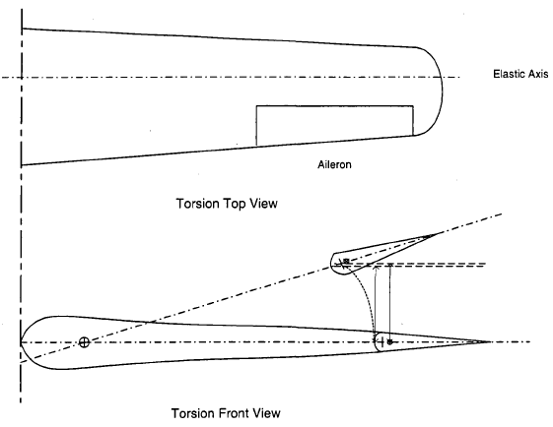
Torsion about the Elastic Axis

Slide 5
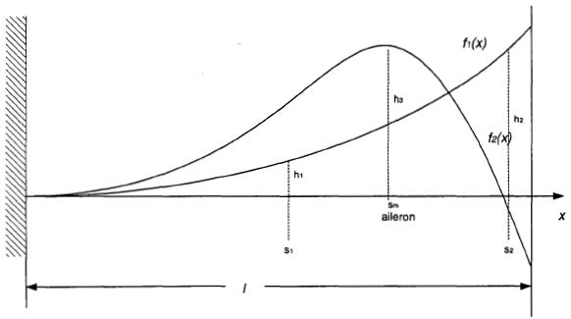
Two Typical Modes

Slide 6
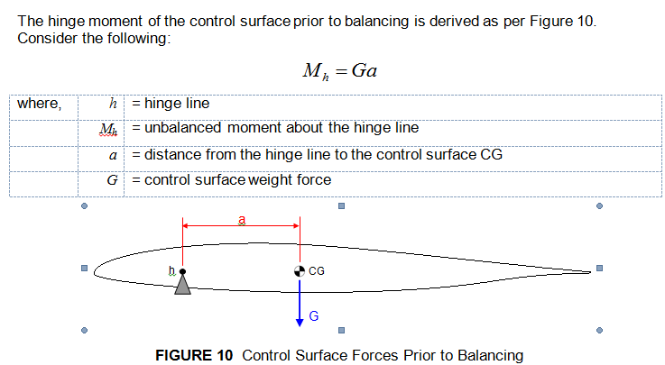
Moving Surface Moment Theory, Slide 1 of 4

Slide 7
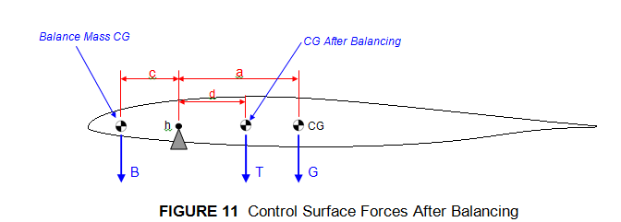
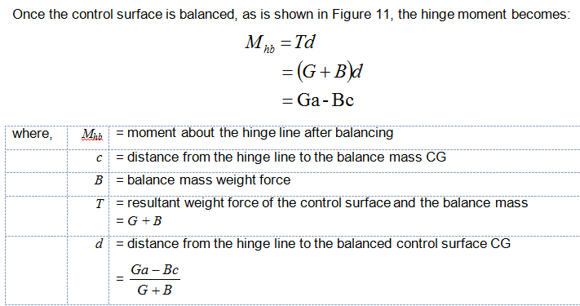
Moving Surface Moment Theory, Slide 2 of 4

Slide 8
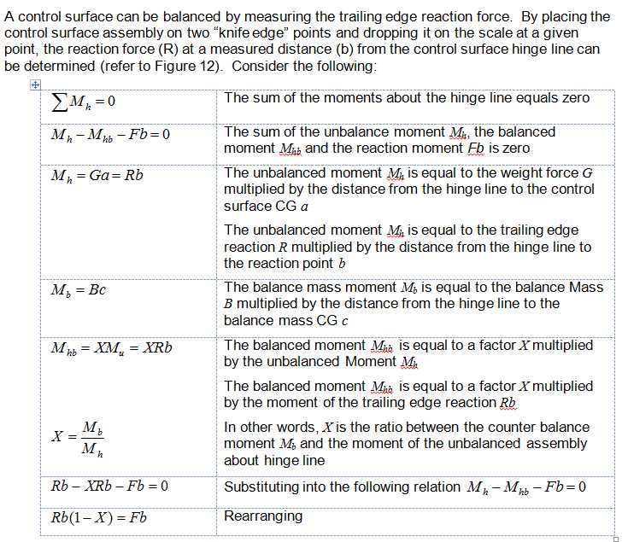
Moving Surface Moment Theory, Slide 3 of 4

Slide 9
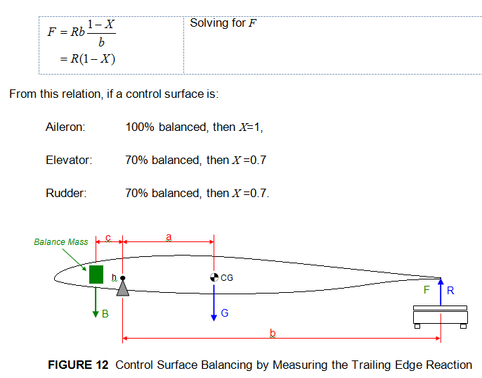
Moving Surface Moment Theory, Slide 4 of 4

Slide 10
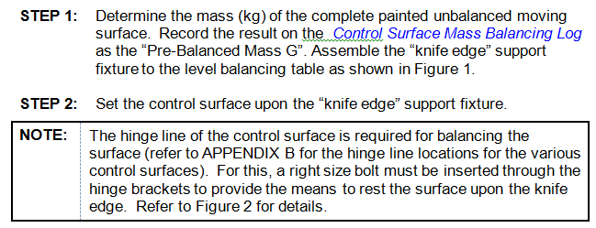
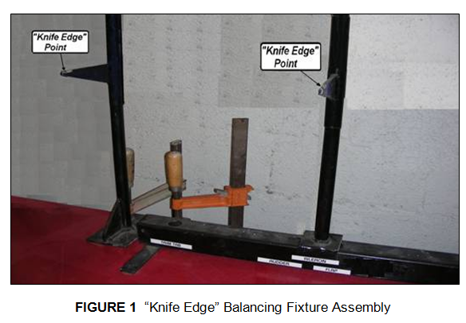
Balancing Moving Surface Step by Step, Slide 1 of 6

Slide 11
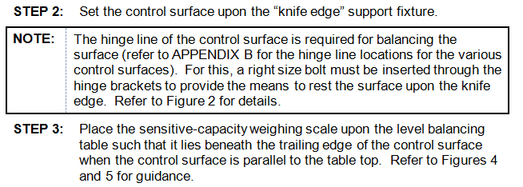
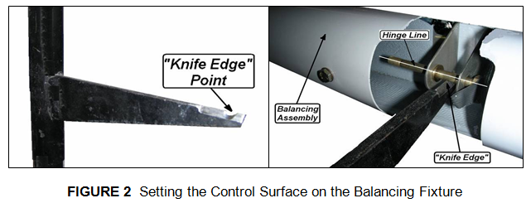
Balancing Moving Surface Step by Step, Slide 2 of 6

Slide 12
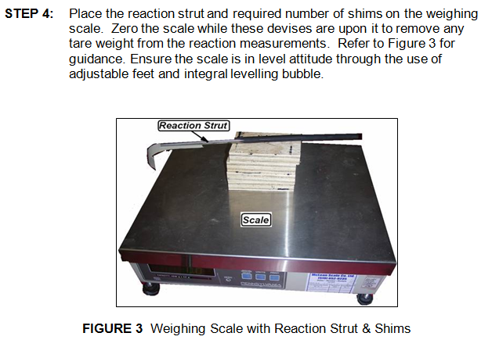
Balancing Moving Surface Step by Step, Slide 3 of 6

Slide 13
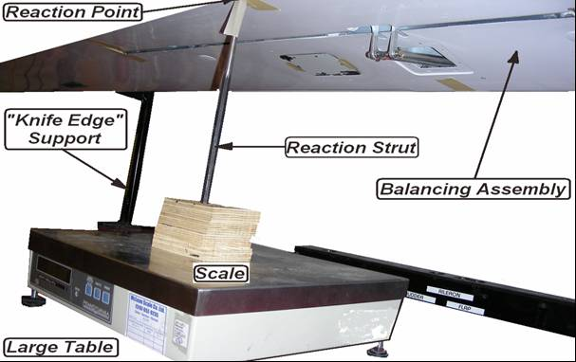
Balancing Moving Surface Step by Step, Slide 4 of 6

Slide 14
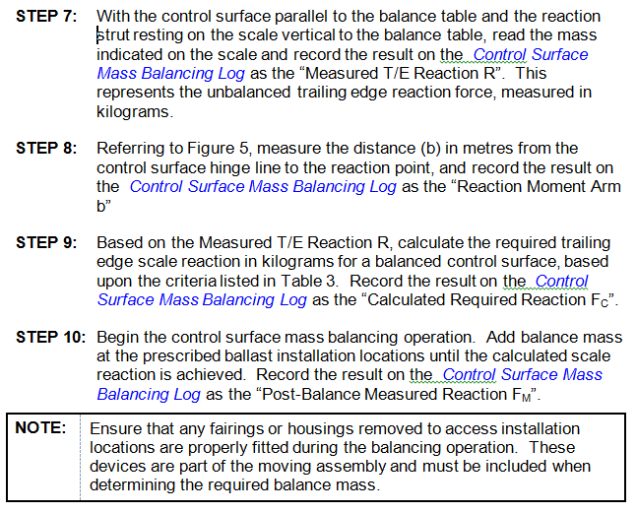
Balancing Moving Surface Step by Step, Slide 5 of 6

Slide 15
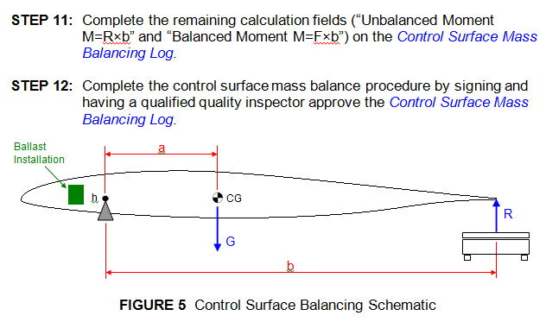
Balancing Moving Surface Step by Step, Slide 6 of 6

Slide 16
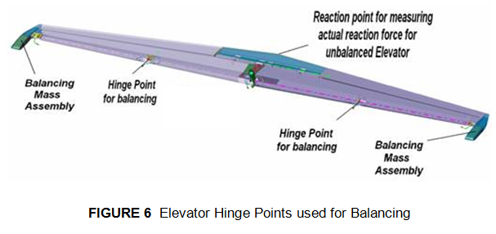
Elevator Hinge Points and Ballast Locations

Slide 17
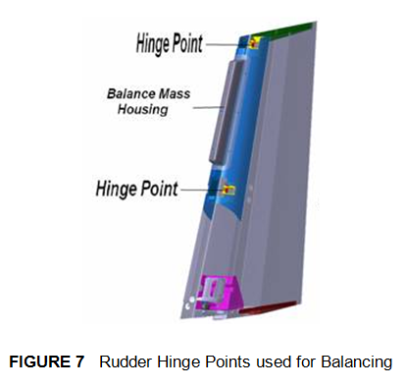
Rudder Hinge Points and Ballast Location

Slide 18
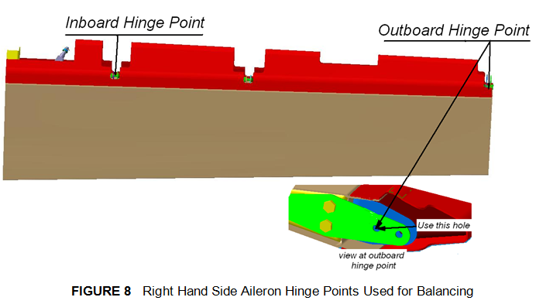
RHS Aileron Hinge Points and Ballast Location

Slide 19
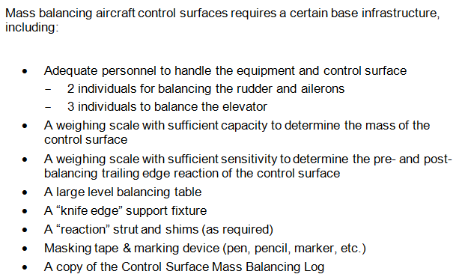
Requirements for Control Surface Balancing

Slide 20
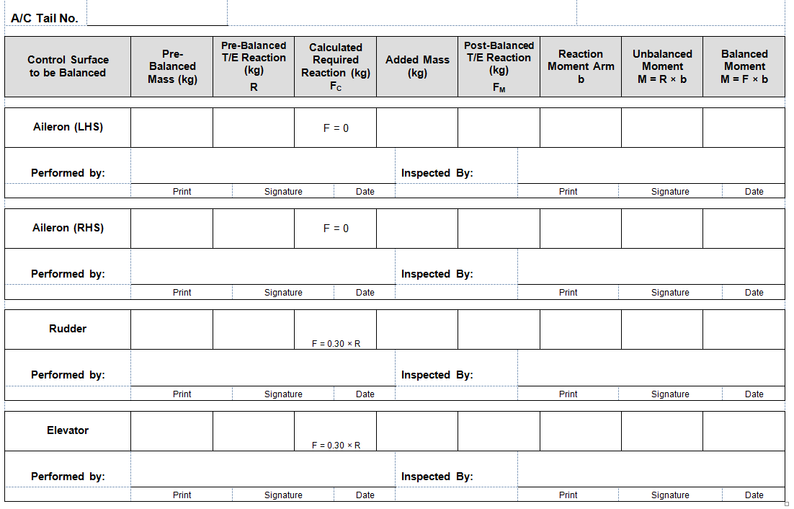
Control Surface Mass Balancing Log Sheet

Slide 21
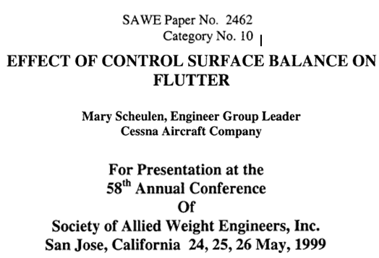
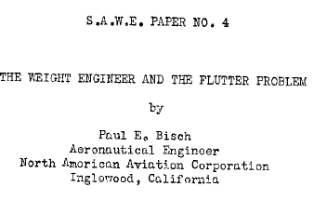
Related papers to read from SAWE: No. 4 and No. 2462

